Slide 1
Serbian proposal for WCCC Belgrade 2016
Venue: Metropol Palace, Belgrade

Slide 2
Belgrade,
Capital of Serbia

Slide 3
The core of today’s two million agglomerations is the Belgrade Fortress and the Kalemegdan Park

Slide 4
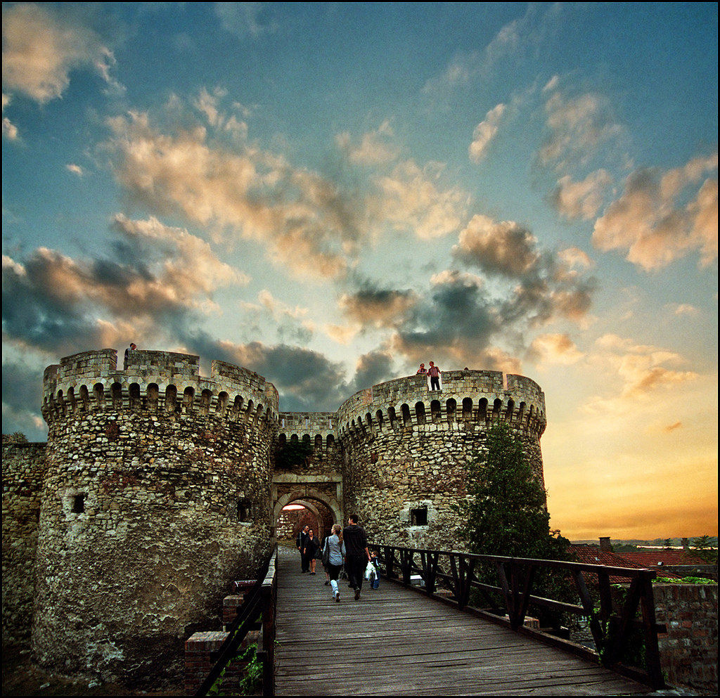

Slide 5
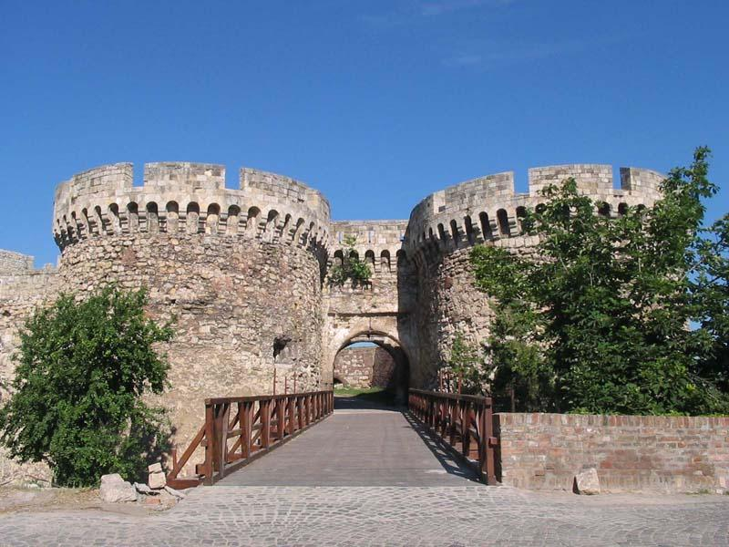

Slide 6
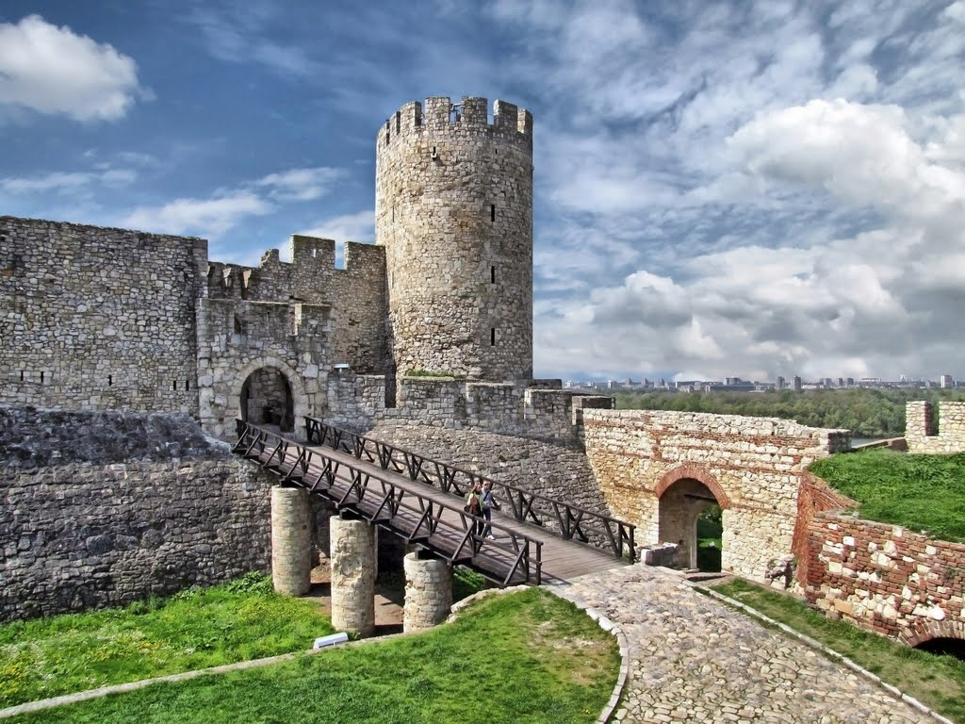

Slide 7
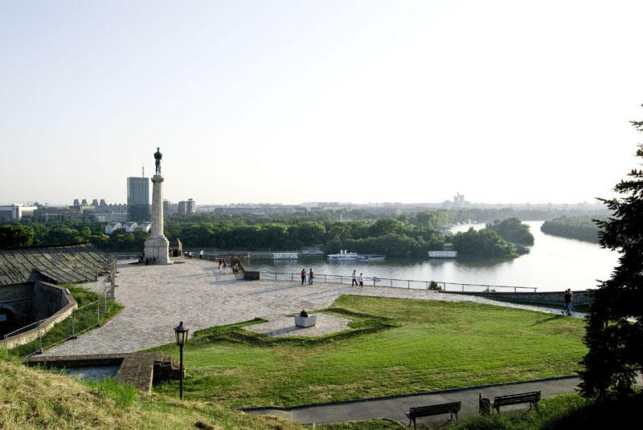

Slide 8
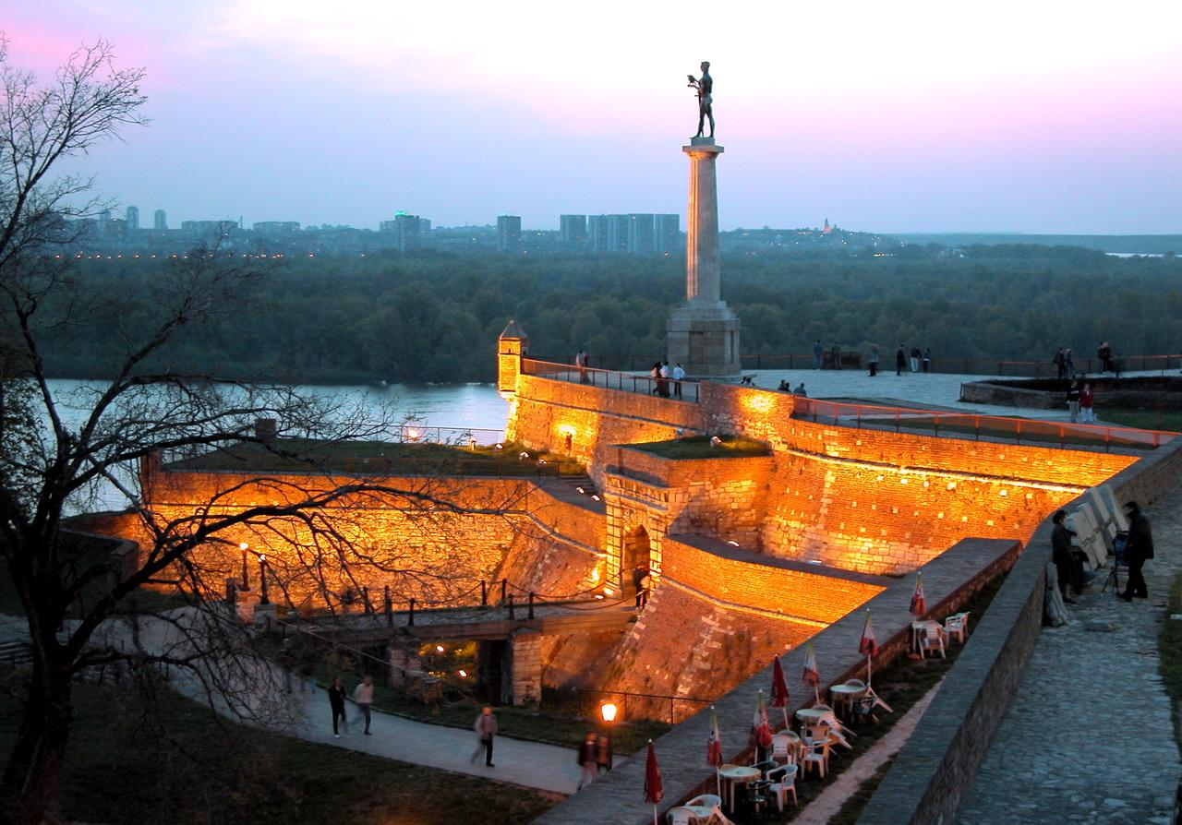

Slide 9
It is here where the Sava River meets the Danube (Dunav), contemplative parkland nudges hectic urban sprawl, and old-world culture gives way to new-world nightlife.

Slide 10
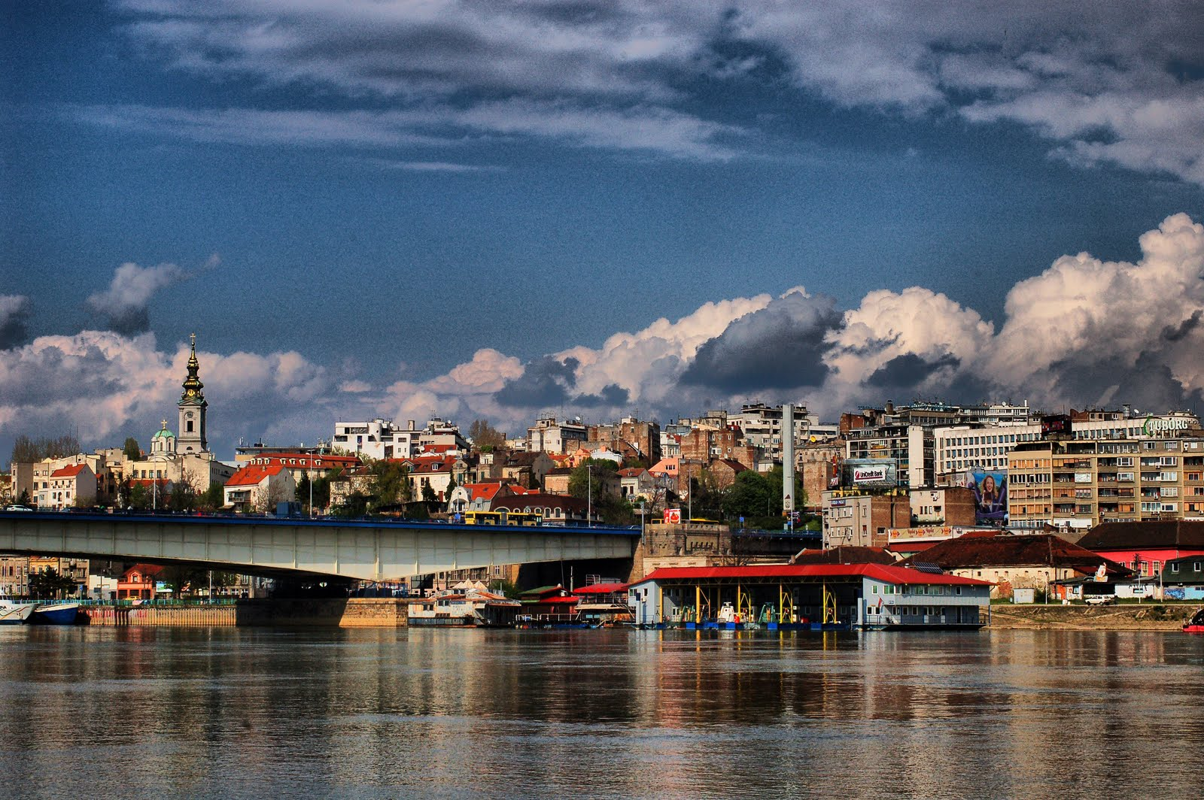

Slide 11
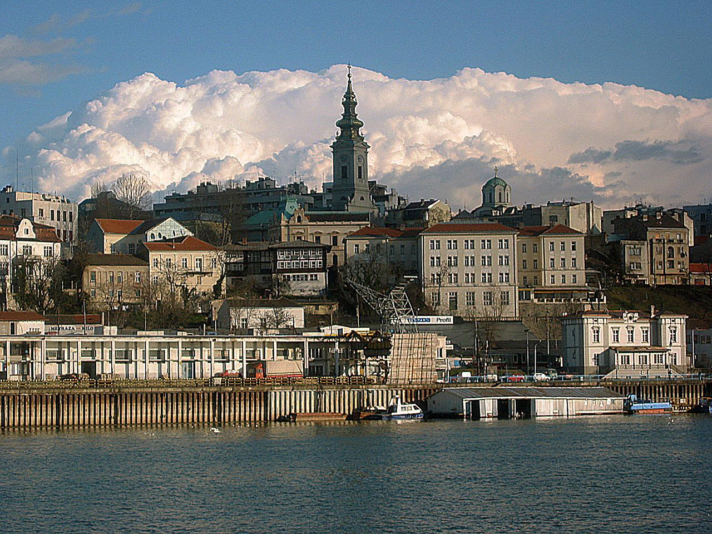
Tekst

Slide 12
Grandiose coffee houses, quirky sidewalk ice-creameries and smoky dens all find rightful place along Knez Mihailova, a lively pedestrian boulevard flanked by historical buildings all the way to the ancient Kalemegdan Citadel, crown of the city.

Slide 13
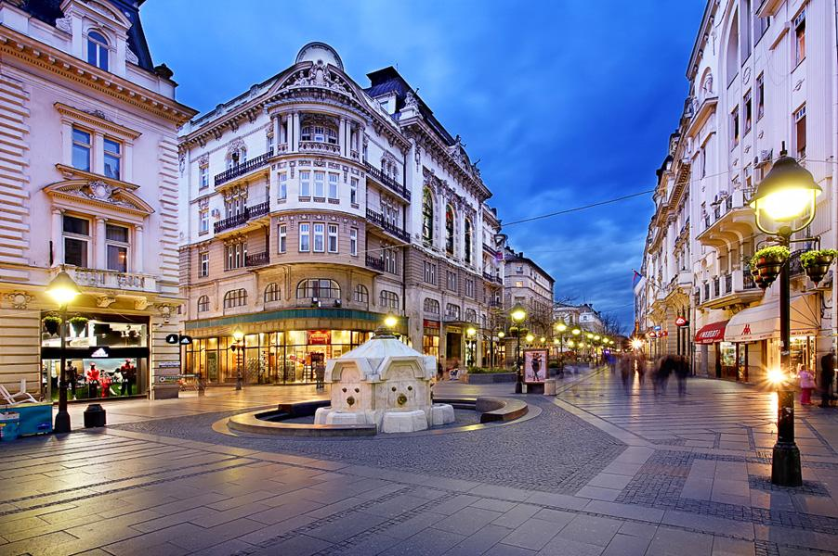

Slide 14
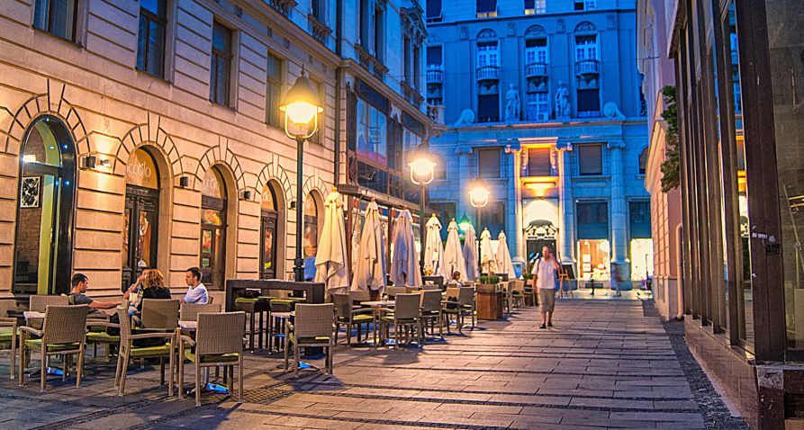

Slide 15
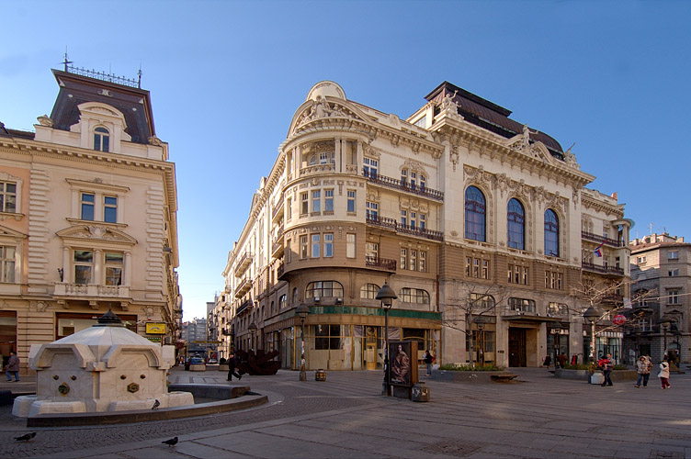

Slide 16
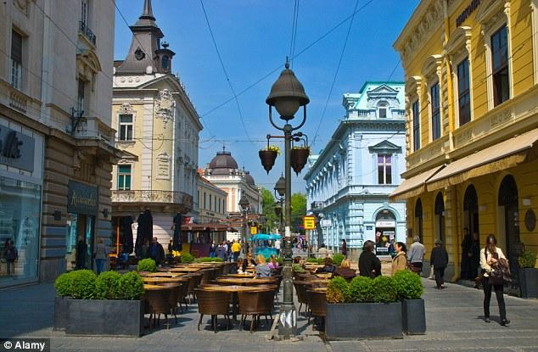

Slide 17
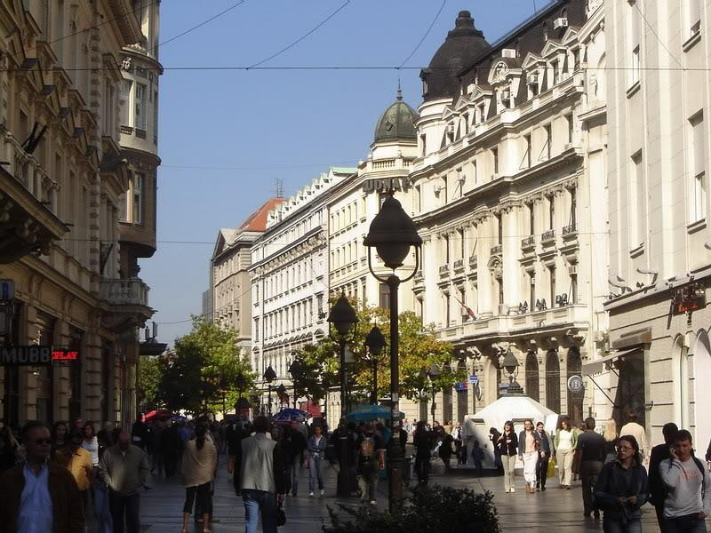

Slide 18
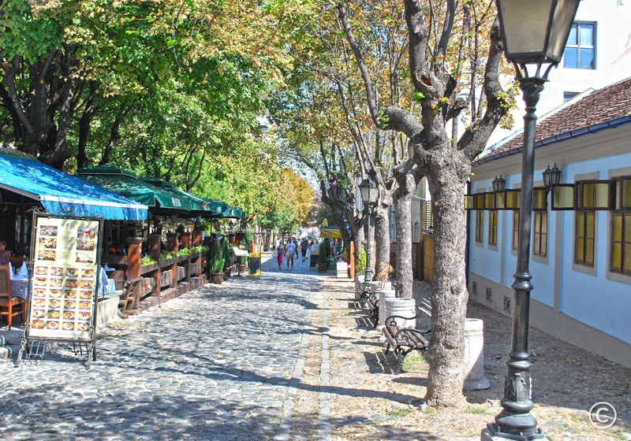
Often hailed as Belgrade's Montmartre, Skadarska was the bohemian hang-out of poets and artists in the early 1900s.

Slide 19
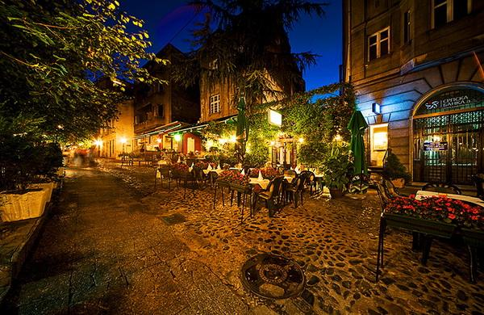
Today this cobbled street is famous for its Balkan taverns, strolling musicians, cafés and art galleries. In summer, the restaurants spill out onto the street,
and music, theatre and cabaret performers entertain customers and passers-by.

Slide 20
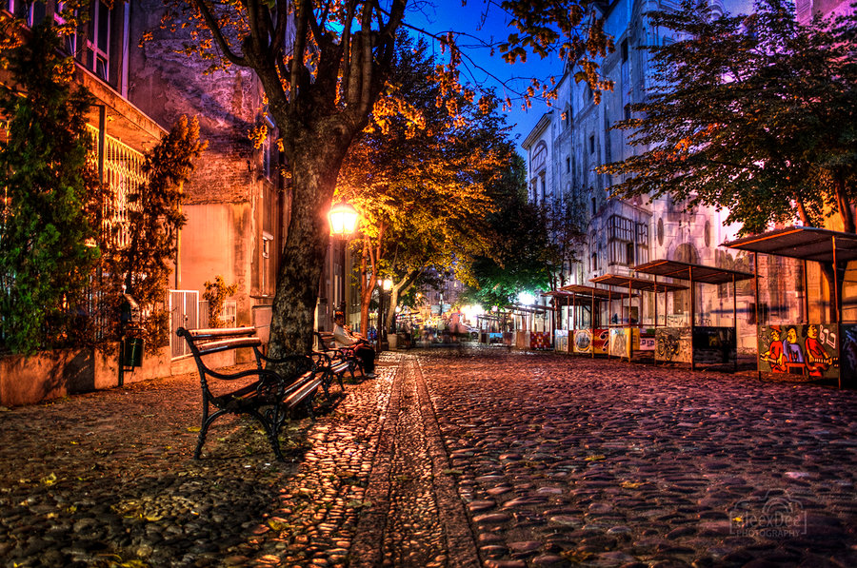

Slide 21
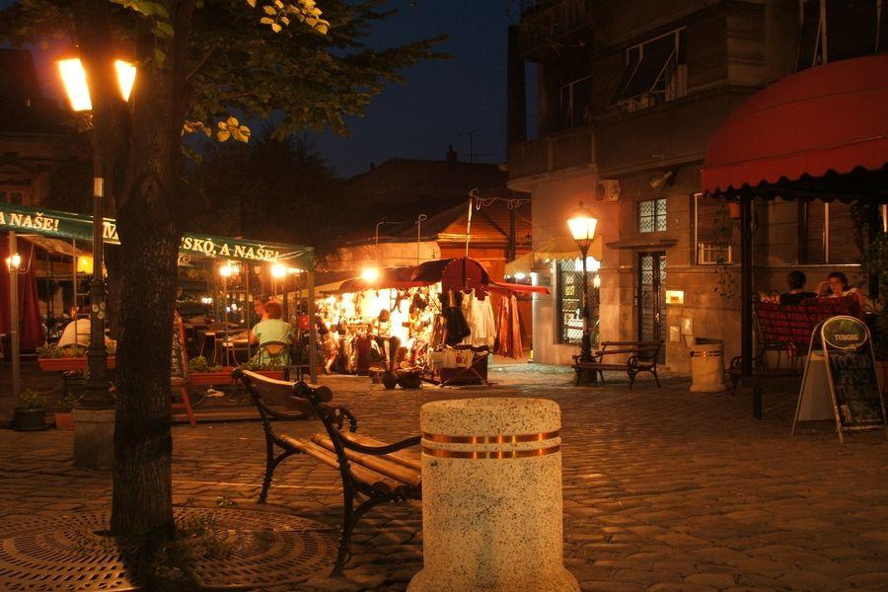

Slide 22
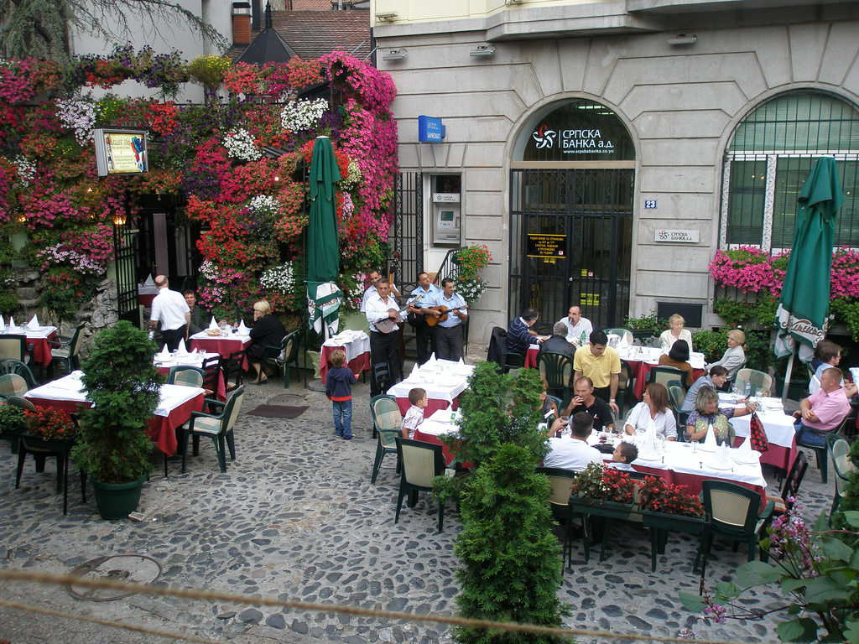

Slide 23
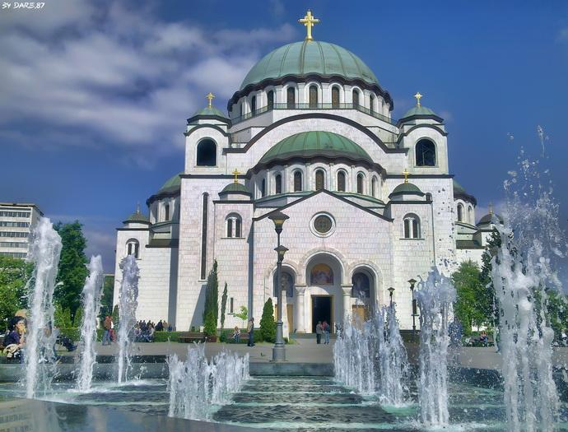
Sveti Sava is the world's biggest Orthodox church, a fact made entirely obvious when looking at the city skyline from a distance or standing under its dome.

Slide 24
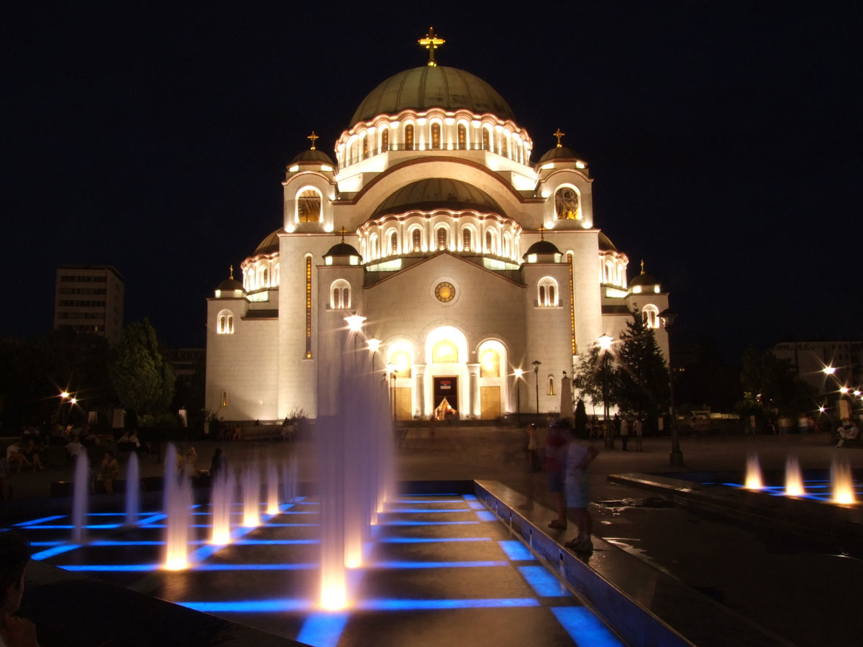

Slide 25
There are 27 airline carriers operating in Belgrade, comprising 19 international carriers, 7 low cost carriers and 1 national carrier. Belgrade has a direct flight connection from around 60 major European, Middle East (Abu Dhabi, Doha, Dubai) and Africa ports and cities. There are more than 850 flights coming in and out of Belgrade every week and over 3.5 million passengers per a year.

Slide 26
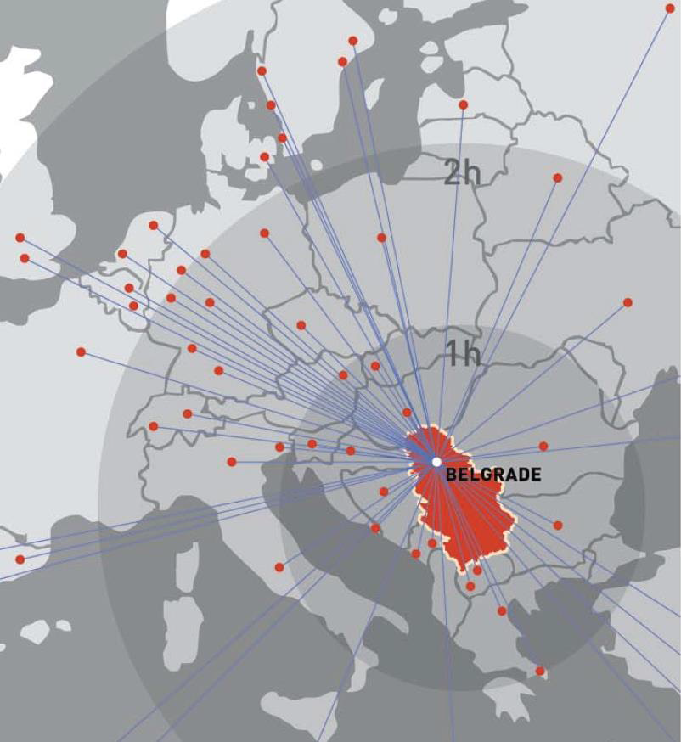

Slide 27
Main Hotel
Metropol Palace 5*

Slide 28
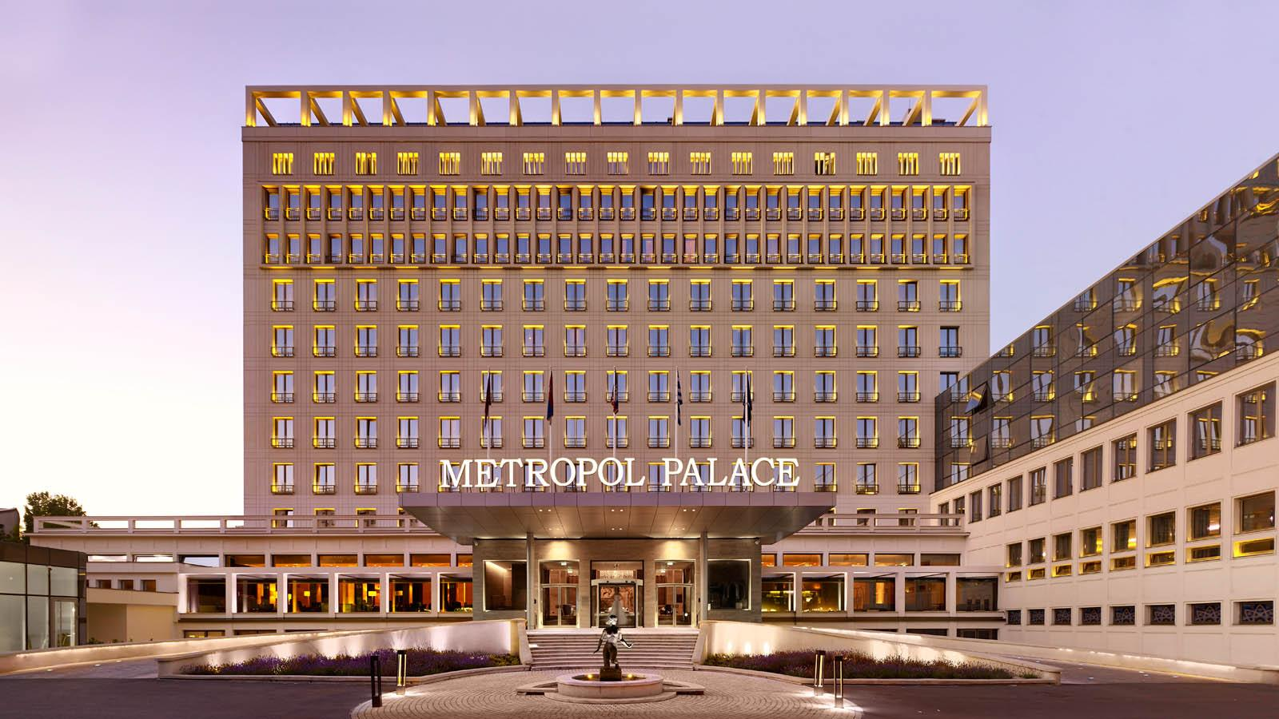

Slide 29
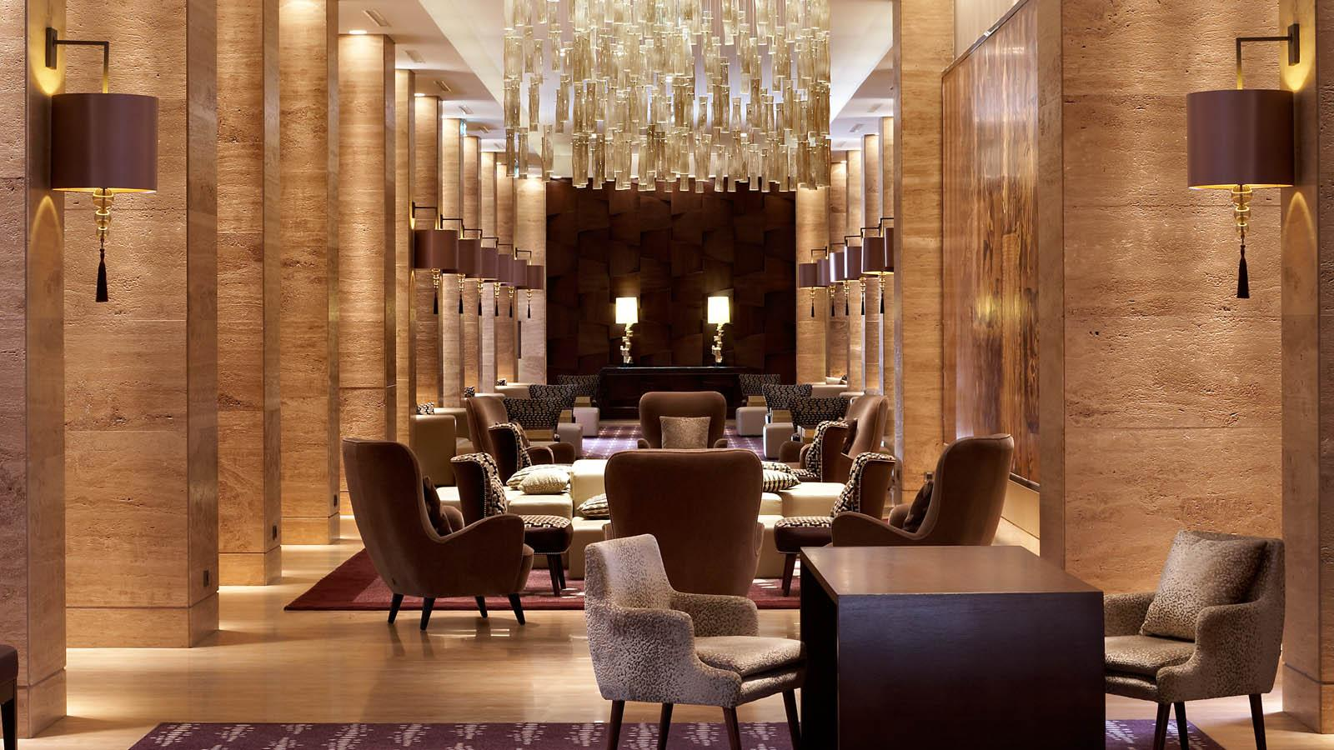

Slide 30
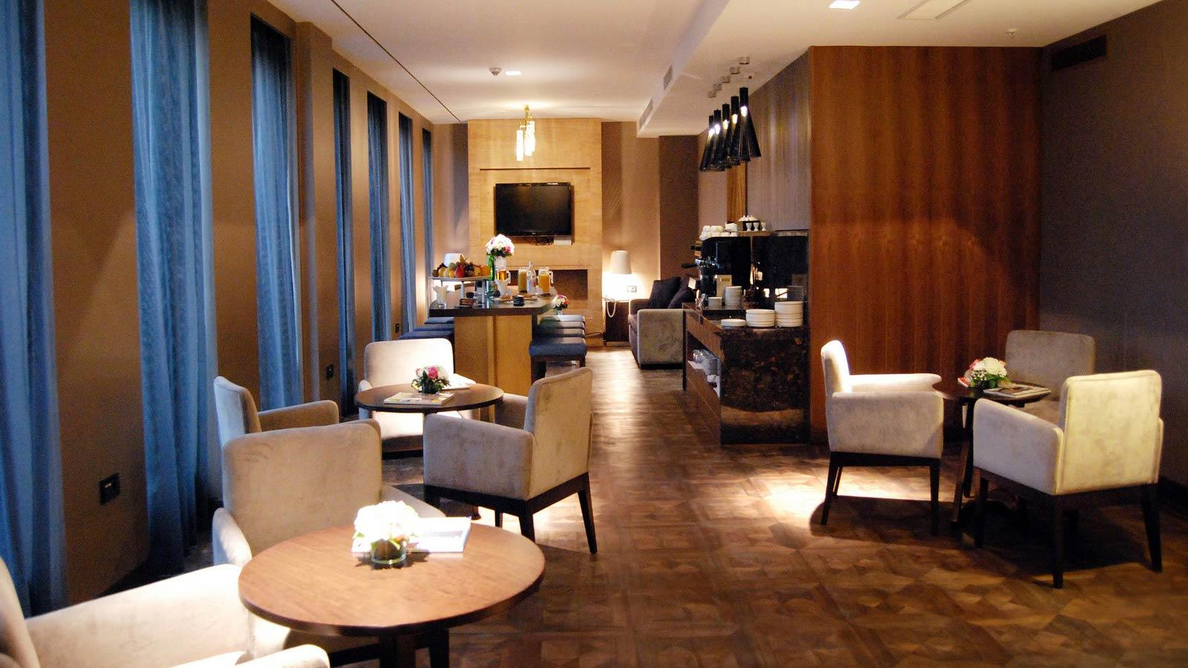

Slide 31
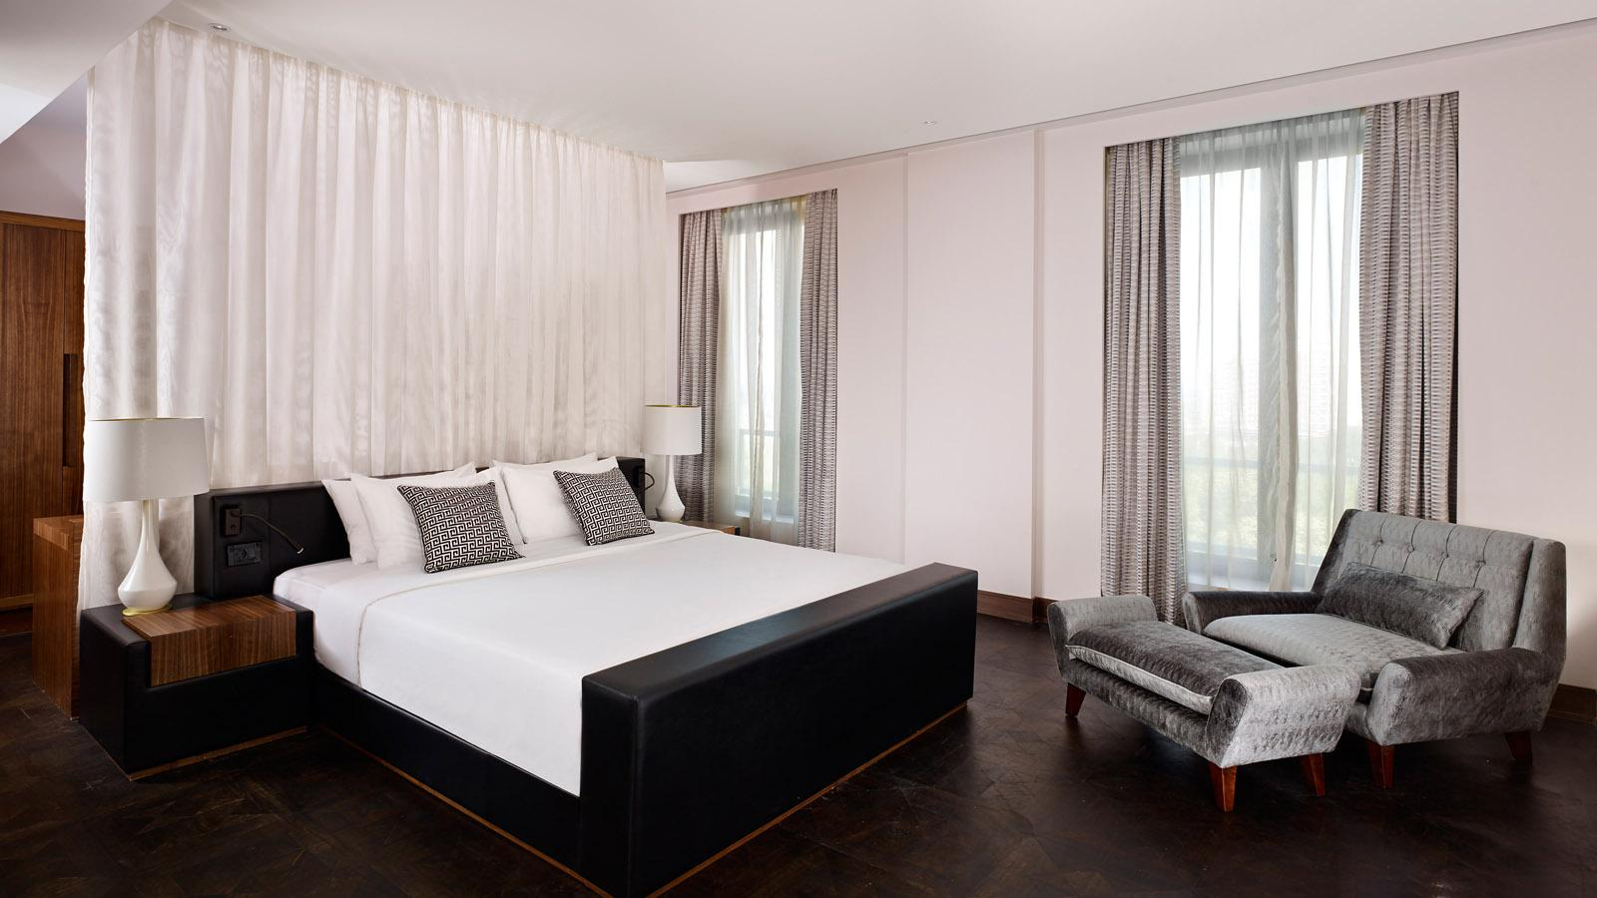

Slide 32
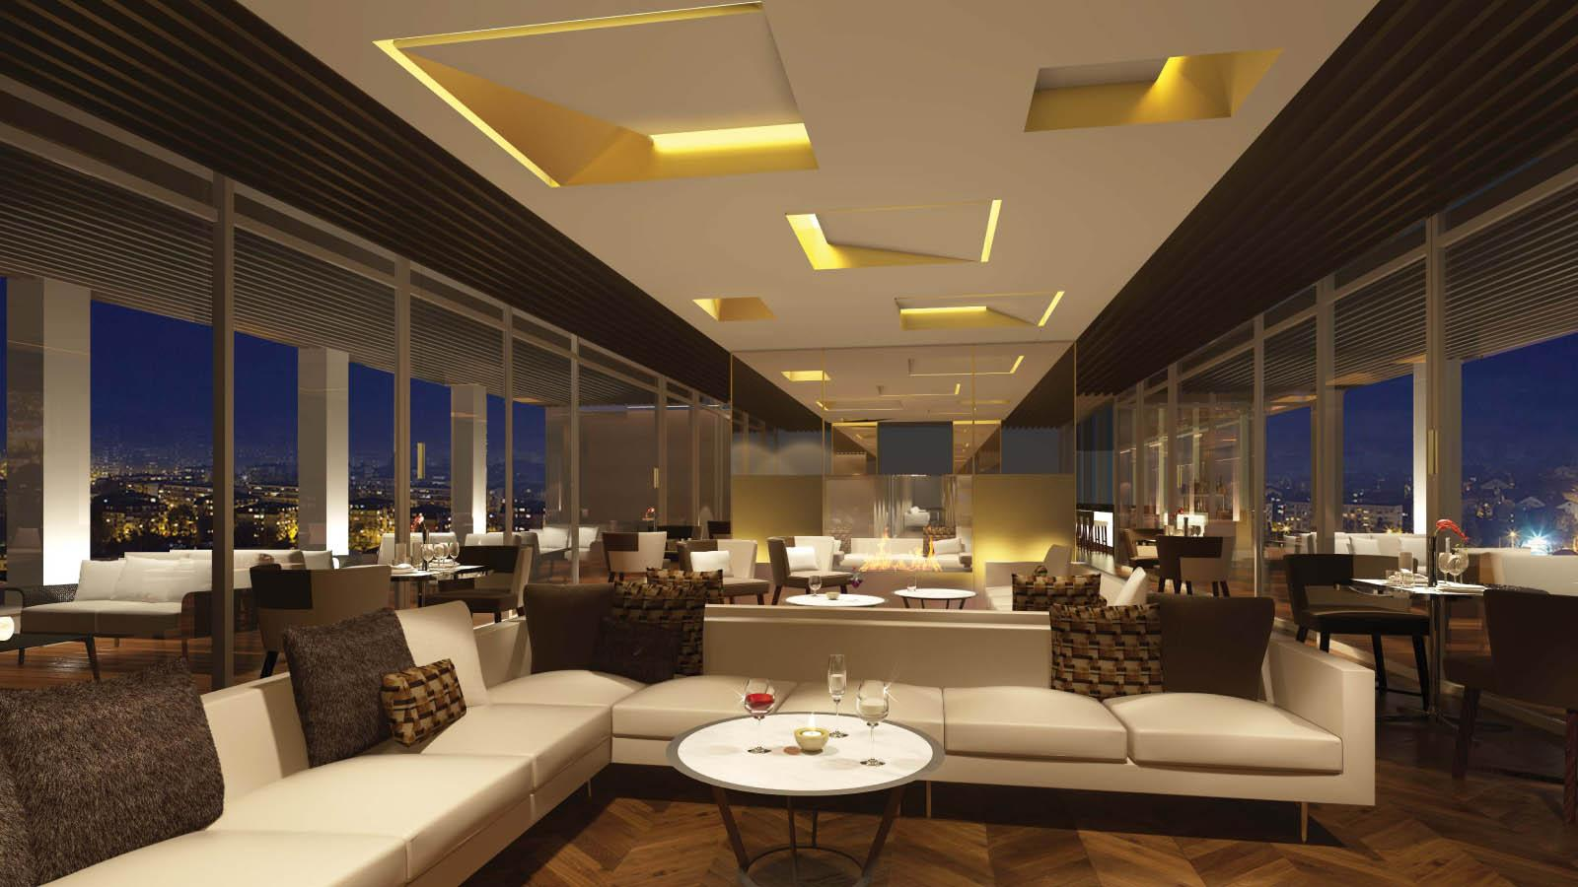

Slide 33
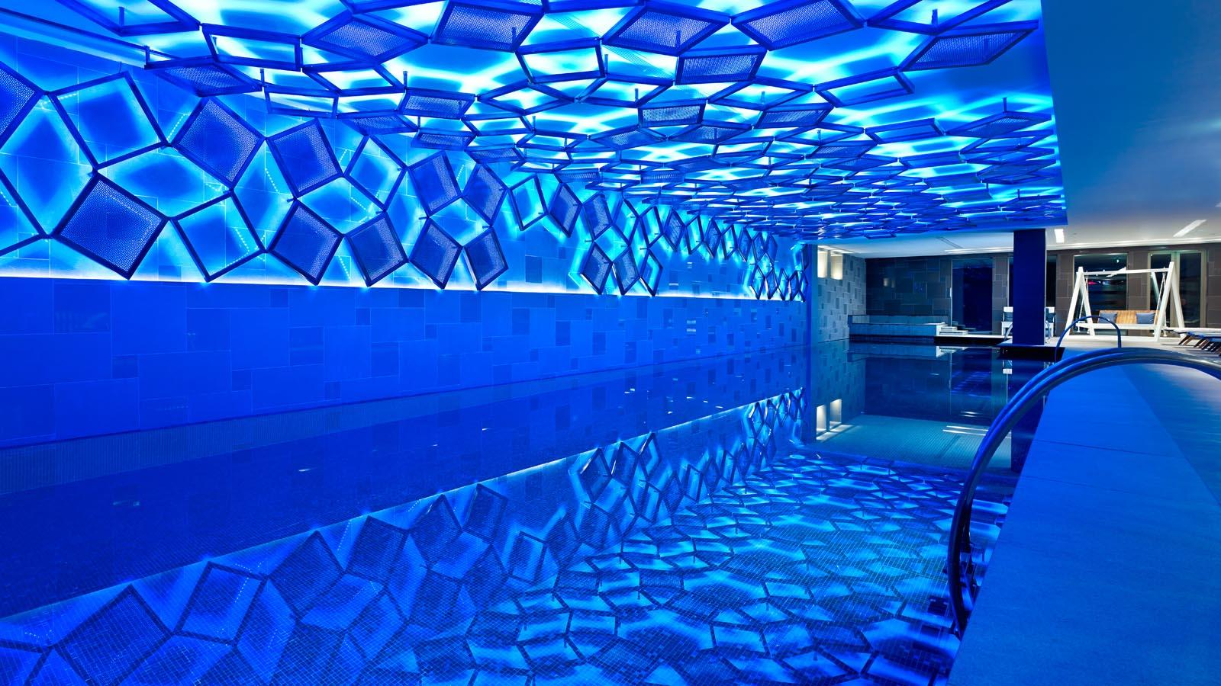

Slide 34
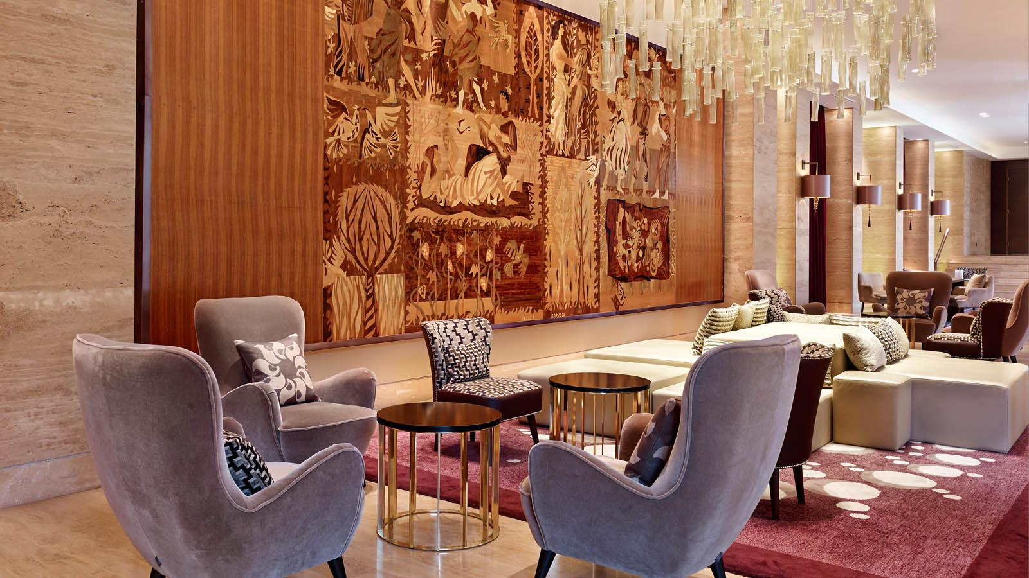

Slide 35
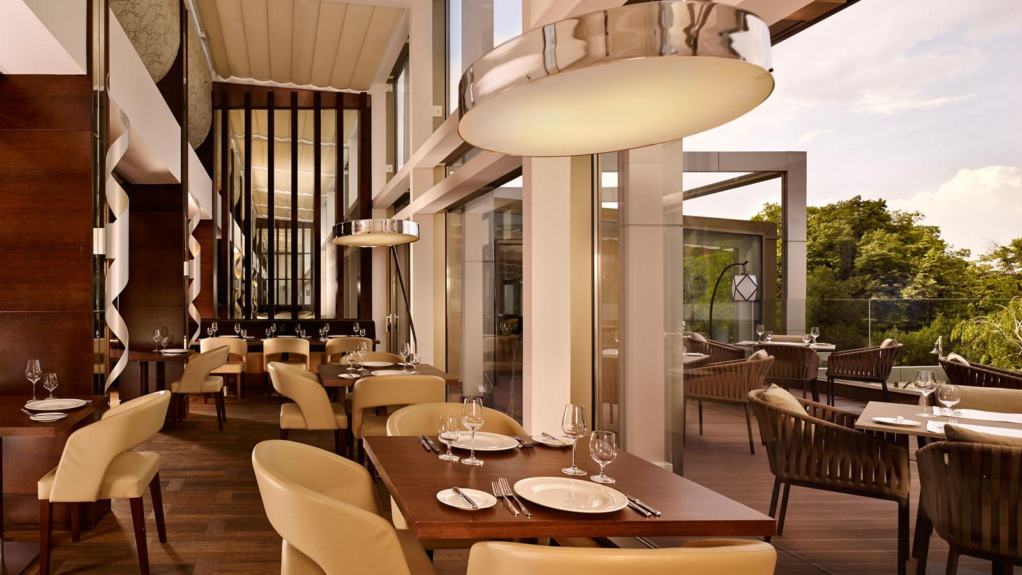

Slide 36
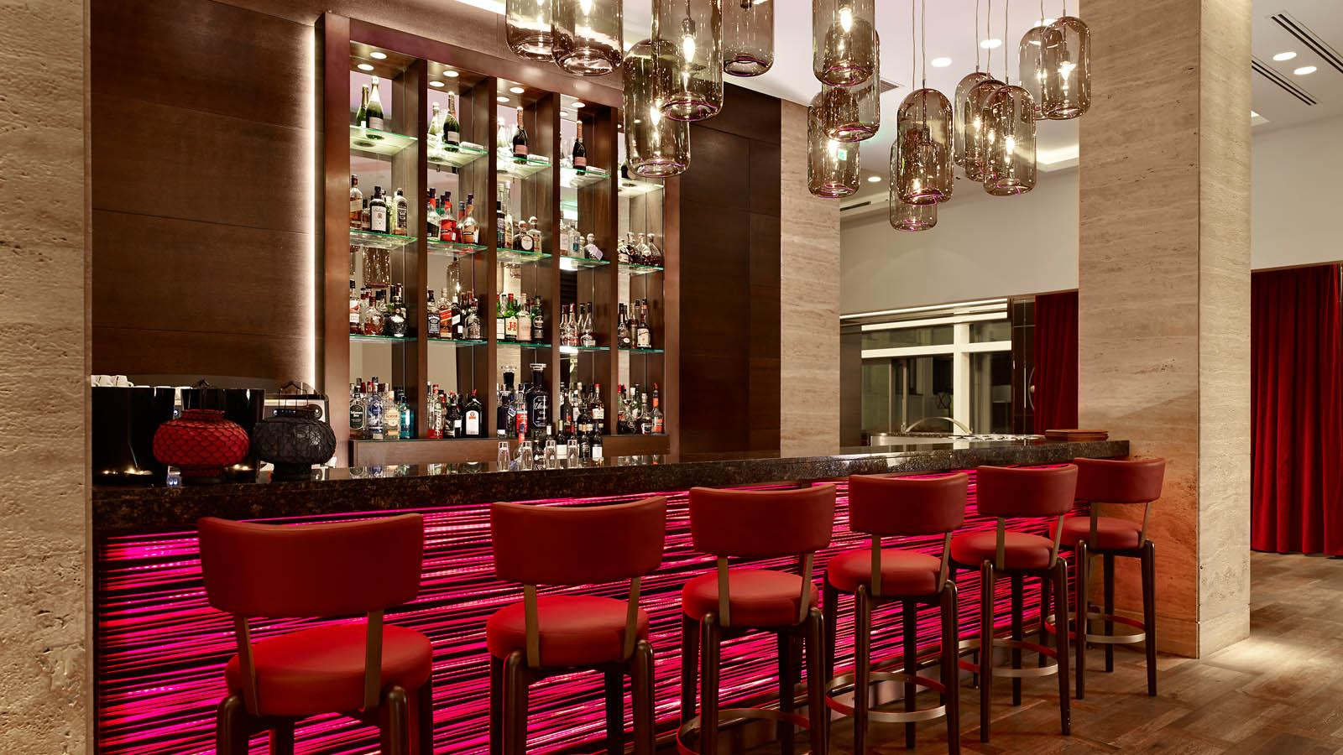

Slide 37
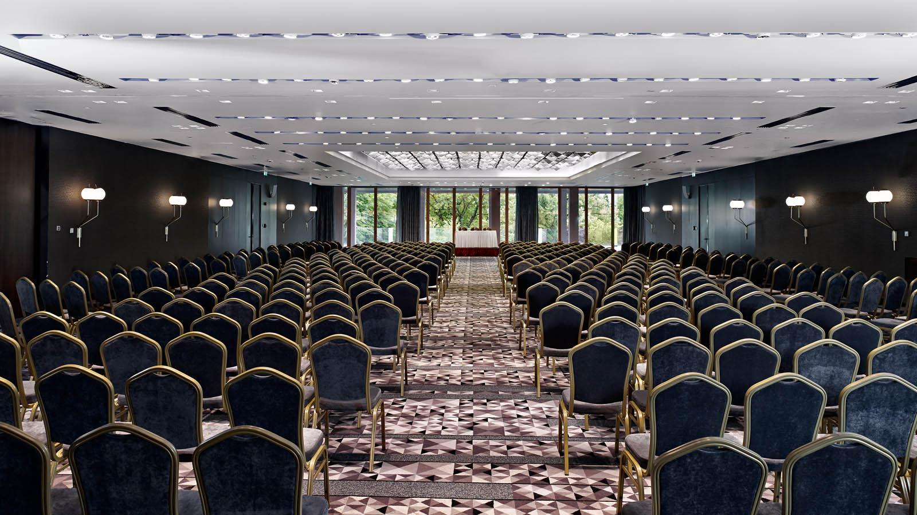

Slide 38
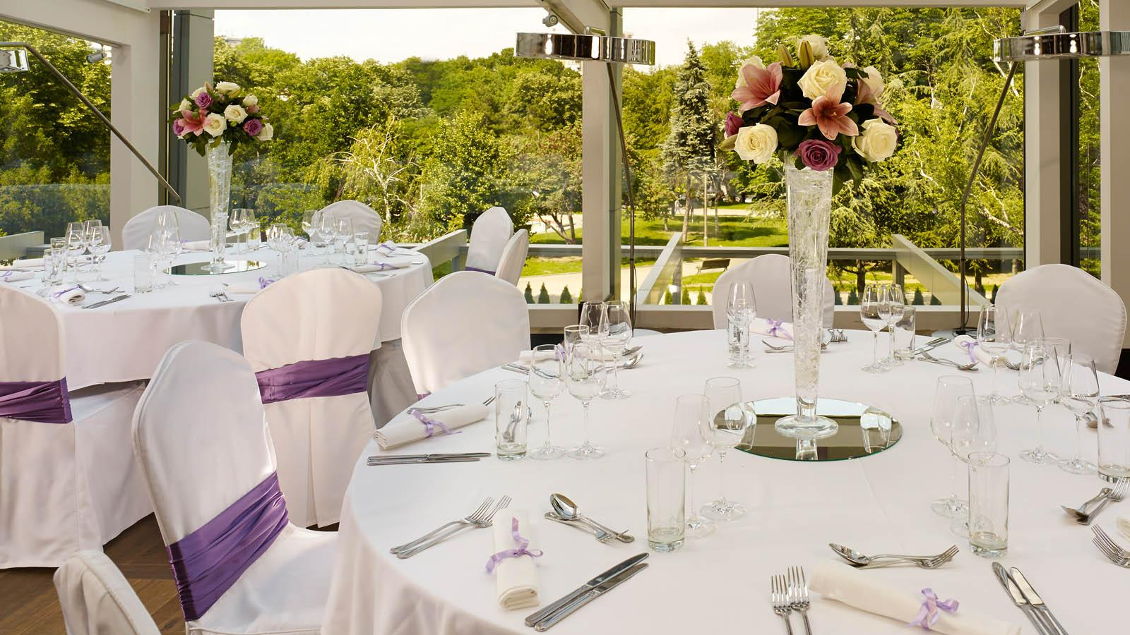

Slide 39
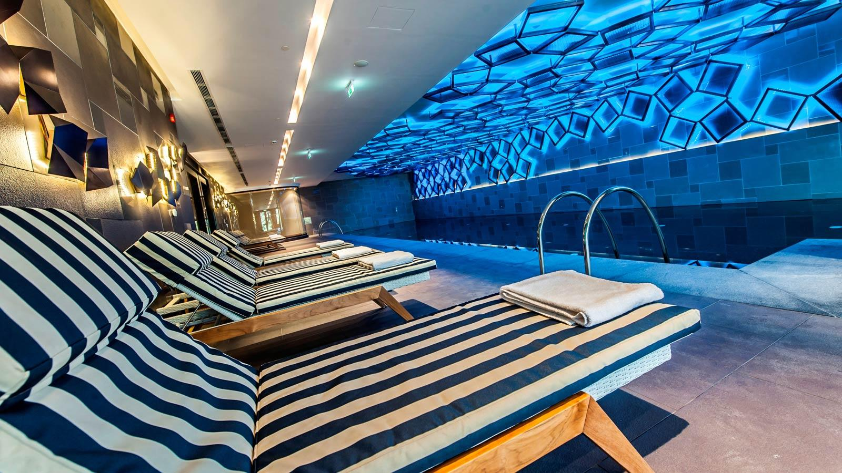

Slide 40
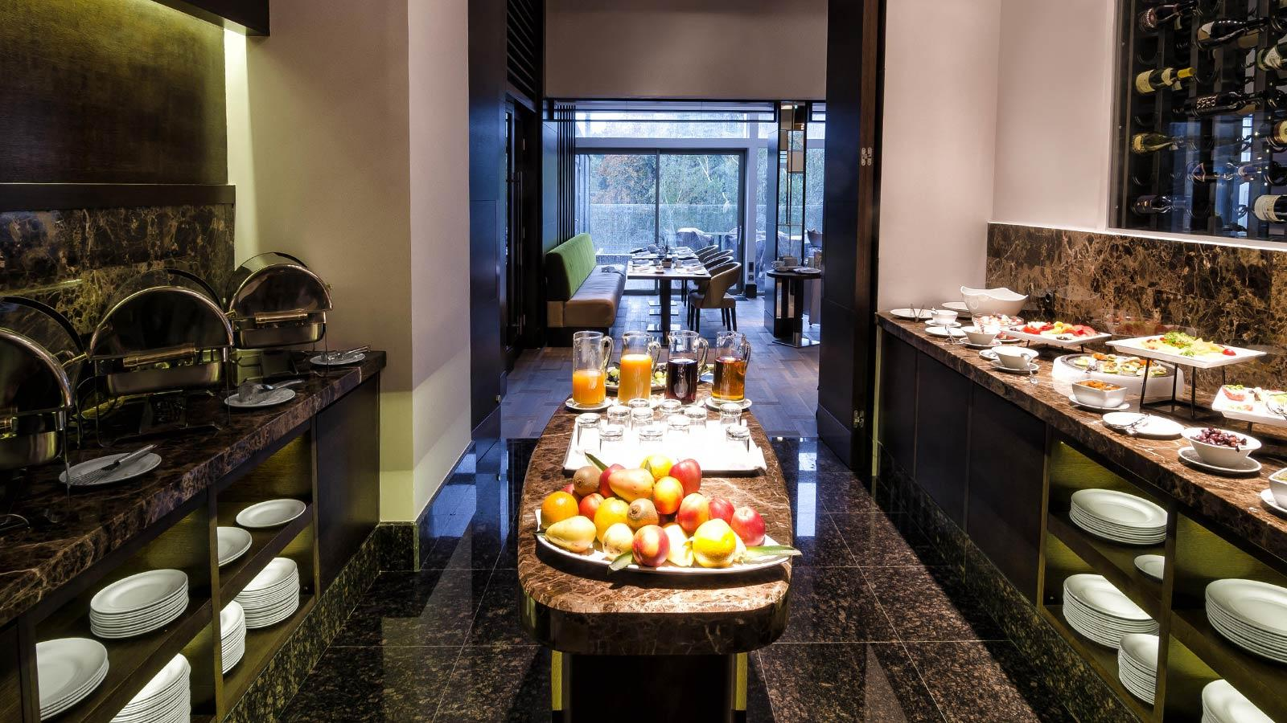

Slide 41
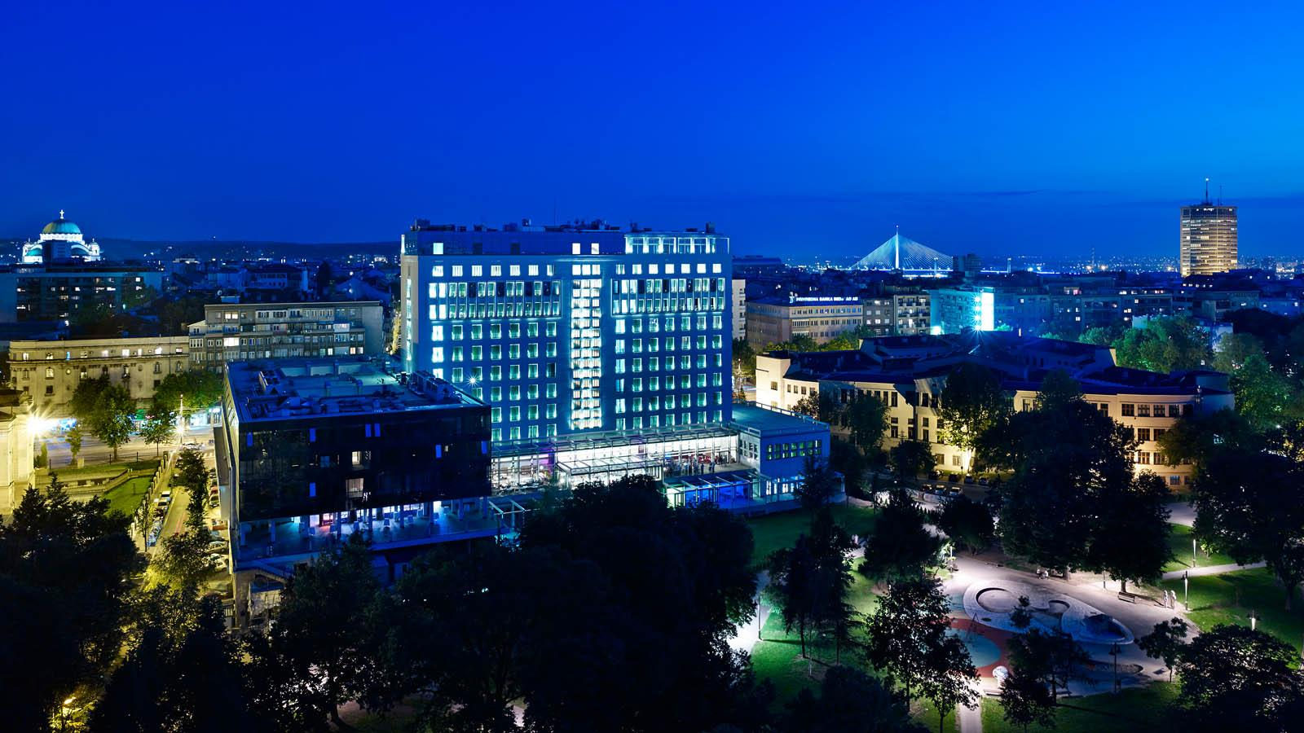

Slide 42
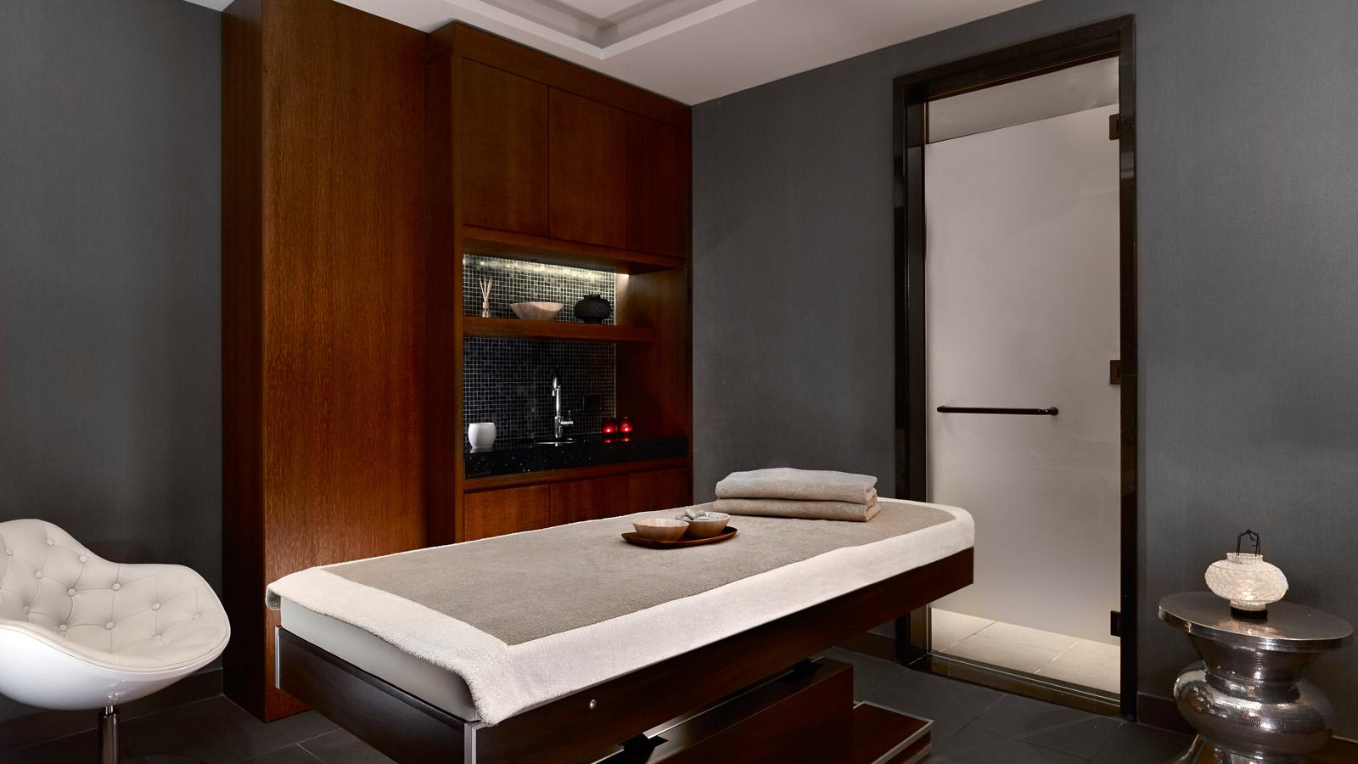

Slide 43
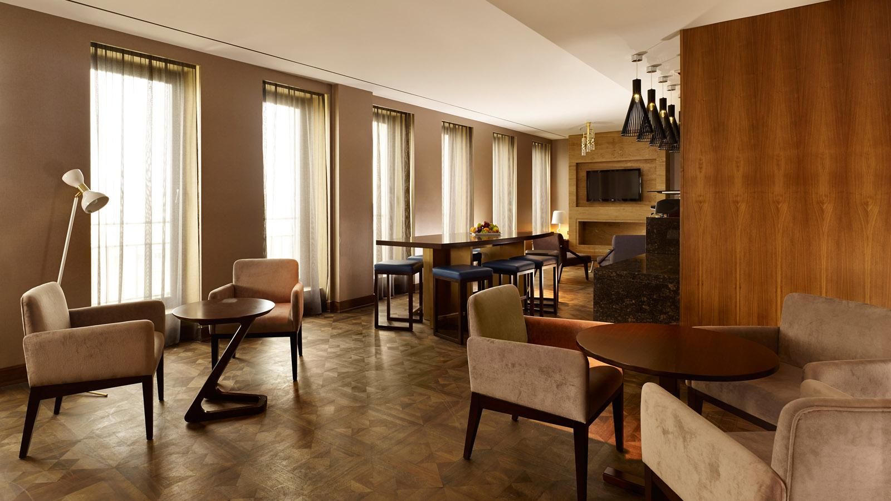

Slide 44
European Individual Women's Championship in 2013 was held in Metropol Palace

Slide 45
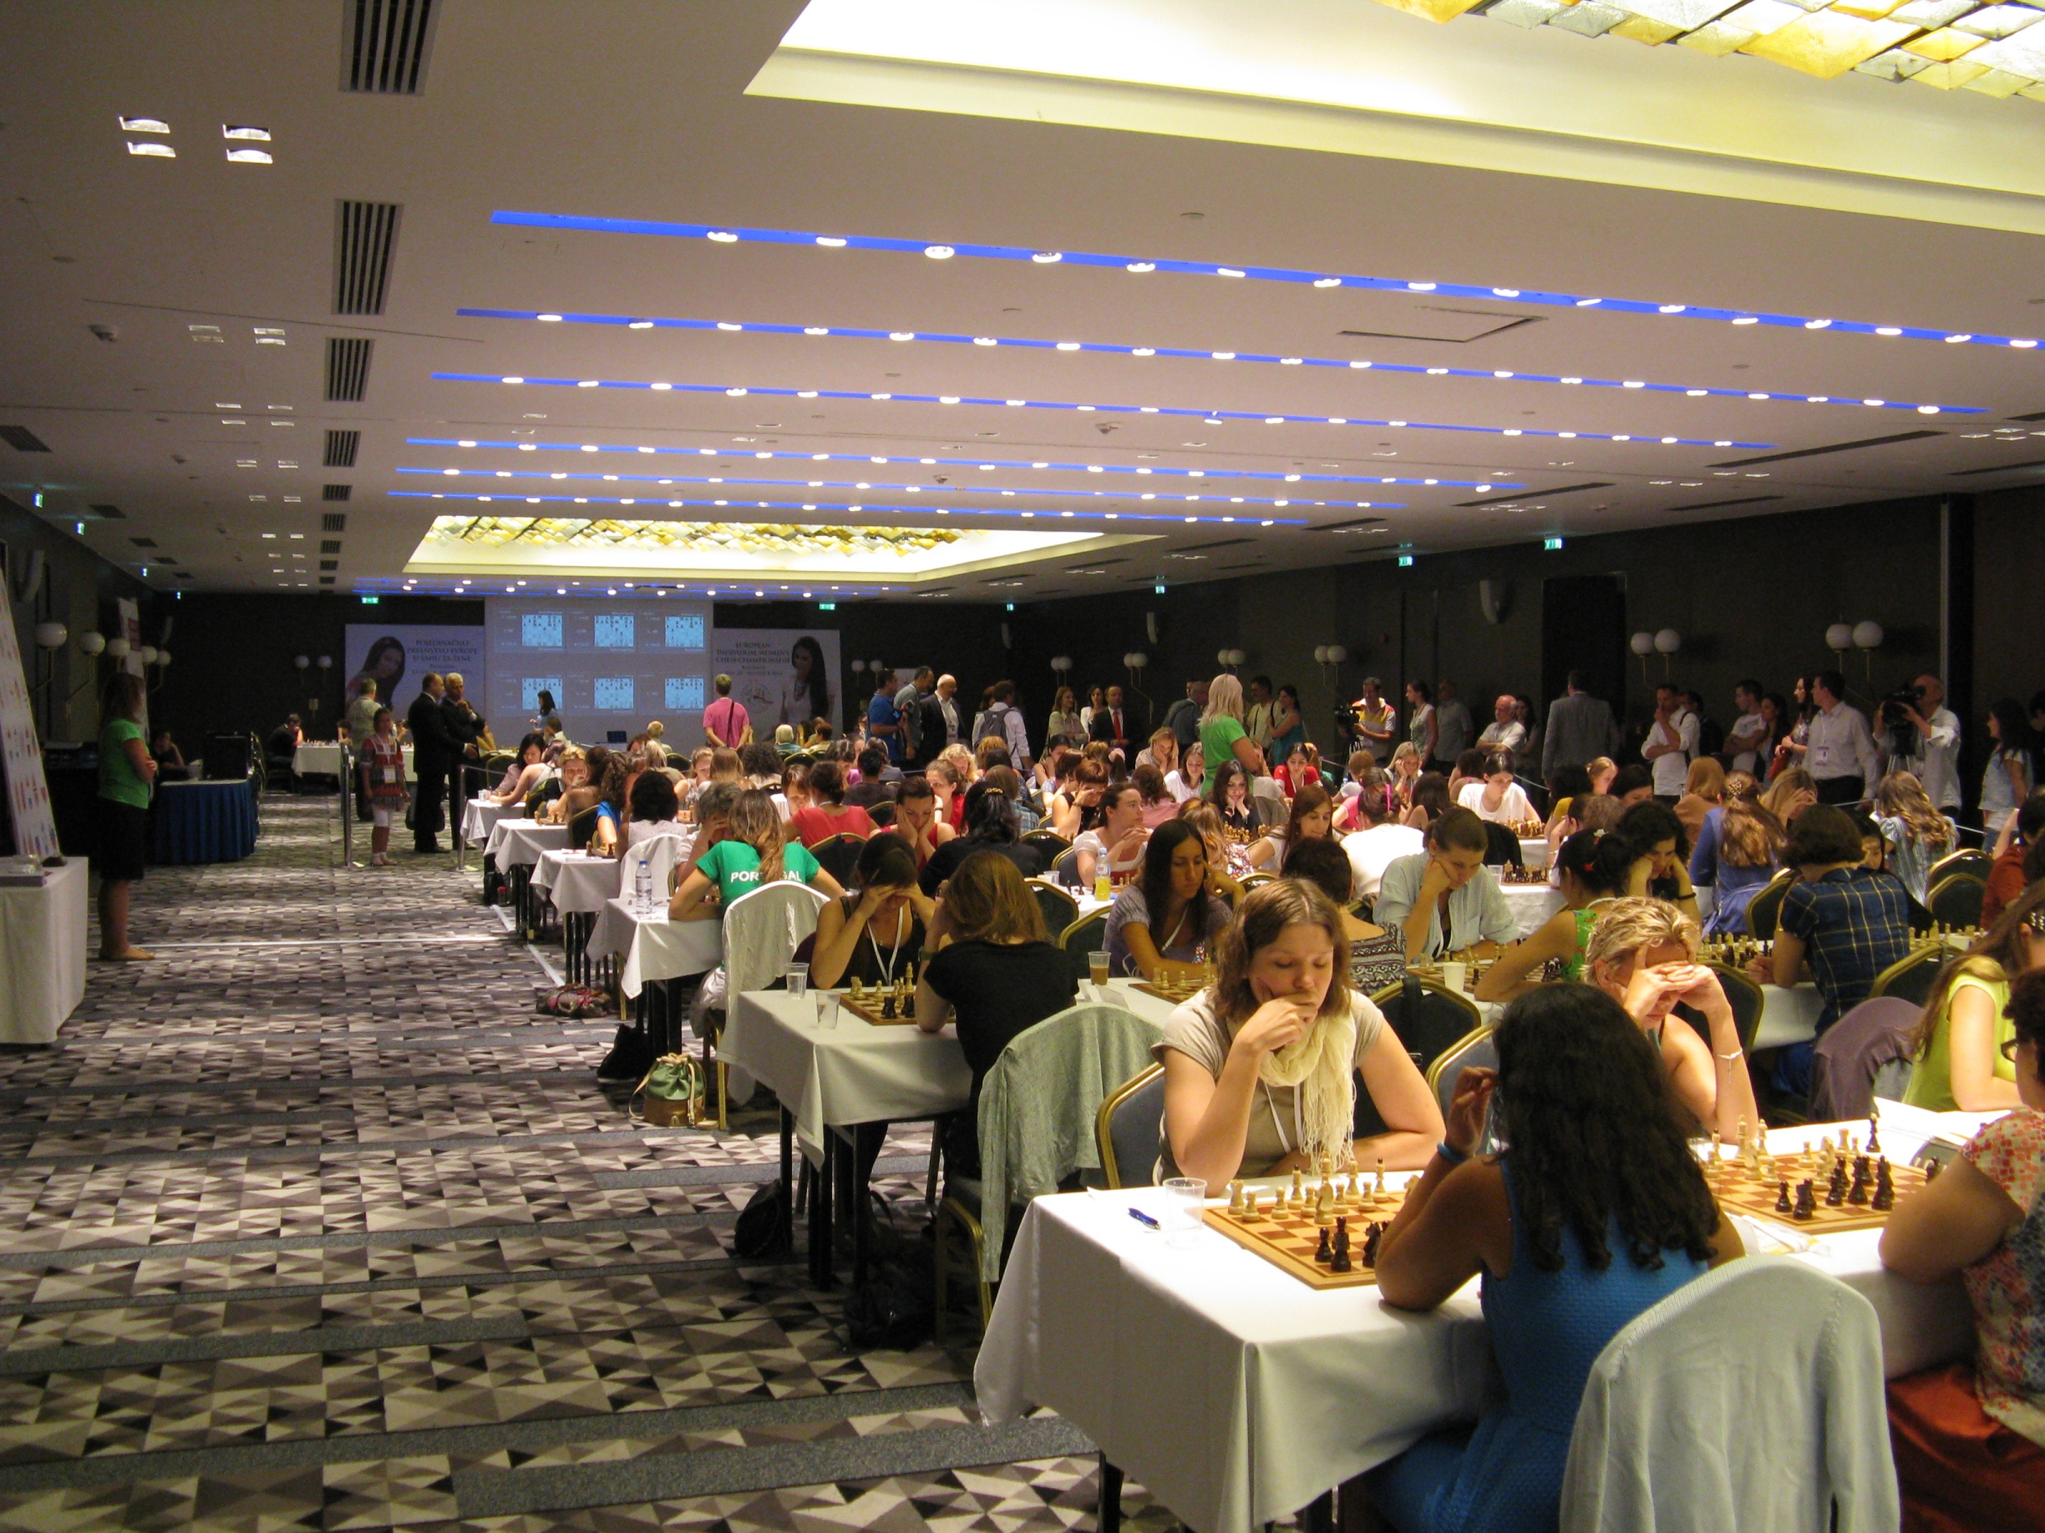

Slide 46
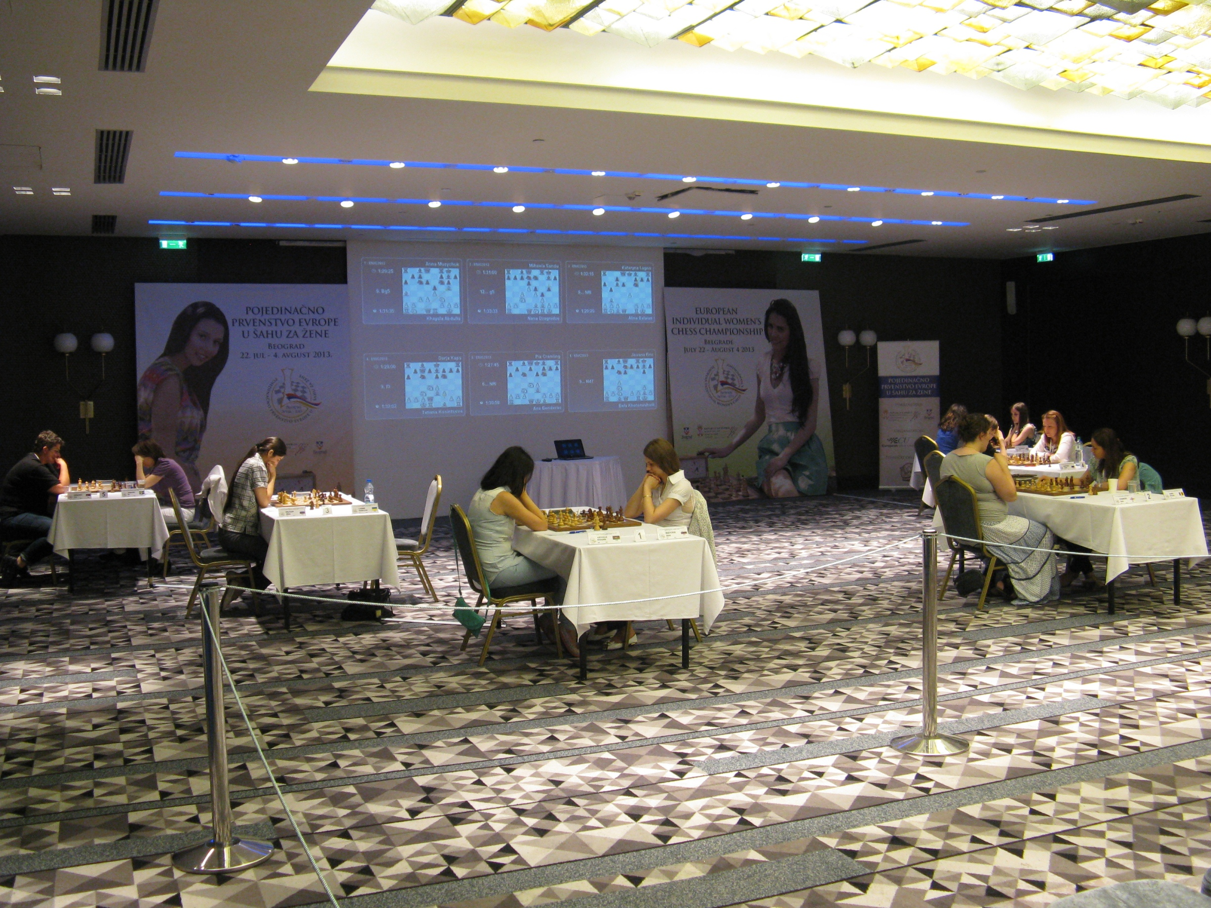

Slide 47
Serbian Chess Problems Society

Slide 48
Around 40 active chess problemists live in Belgrade, including 4 GM solvers and 2 GM composers. Belgrade Chess Club is the the place they meet every Monday.

Slide 49
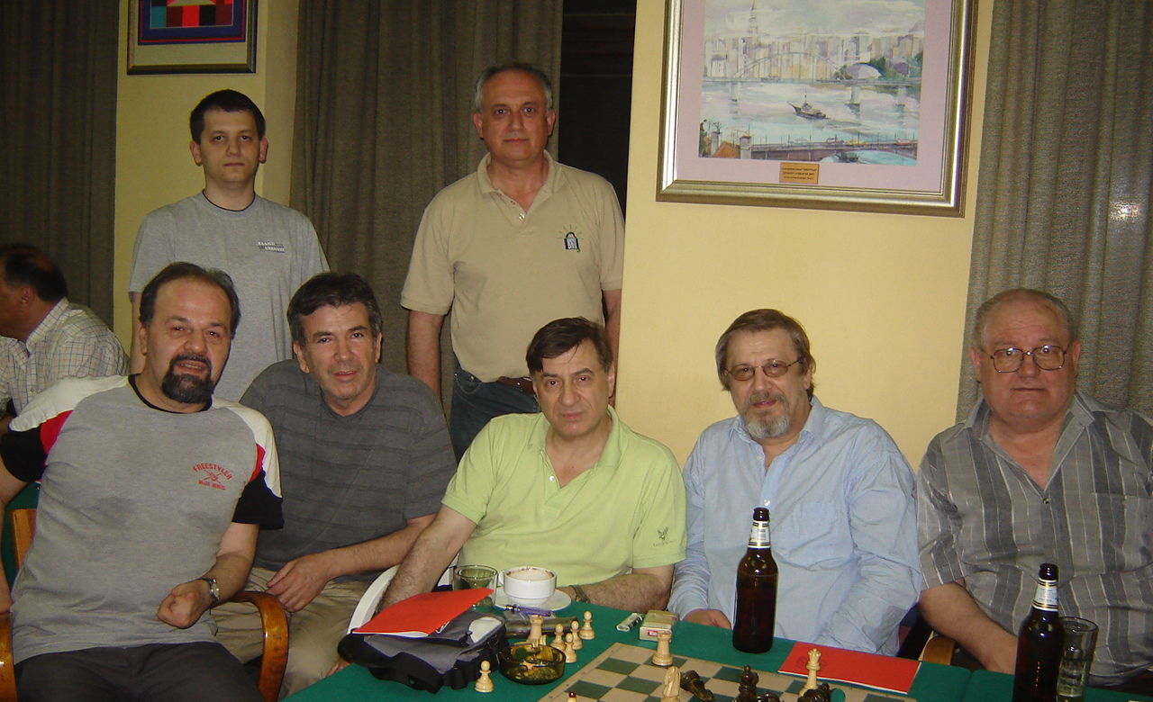
GM Ljubomir Ljubojevic with problemists in the Beograd Chess Club

Slide 50
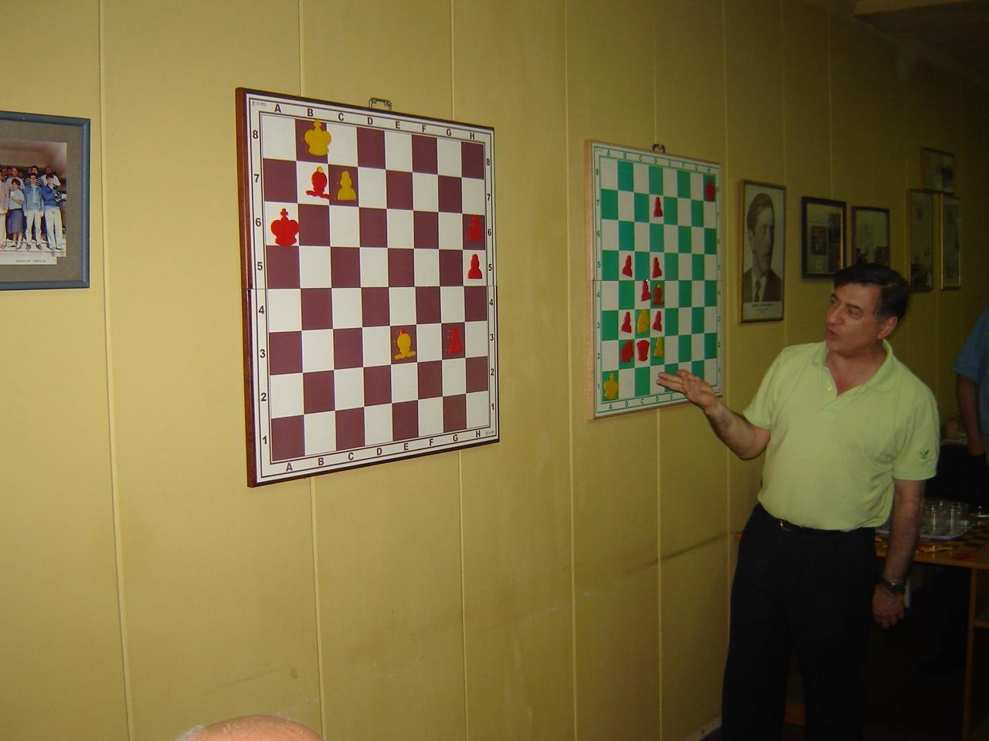
GM Ljubomir Ljubojevic presents a study by Kralin & Pervakov

Slide 51
Belgrade hosts at least 7 yearly solving competitions, including 5 rounds of the League of Solvers, and the Belgrade Problem Chess Festivals (BPCF).

Slide 52
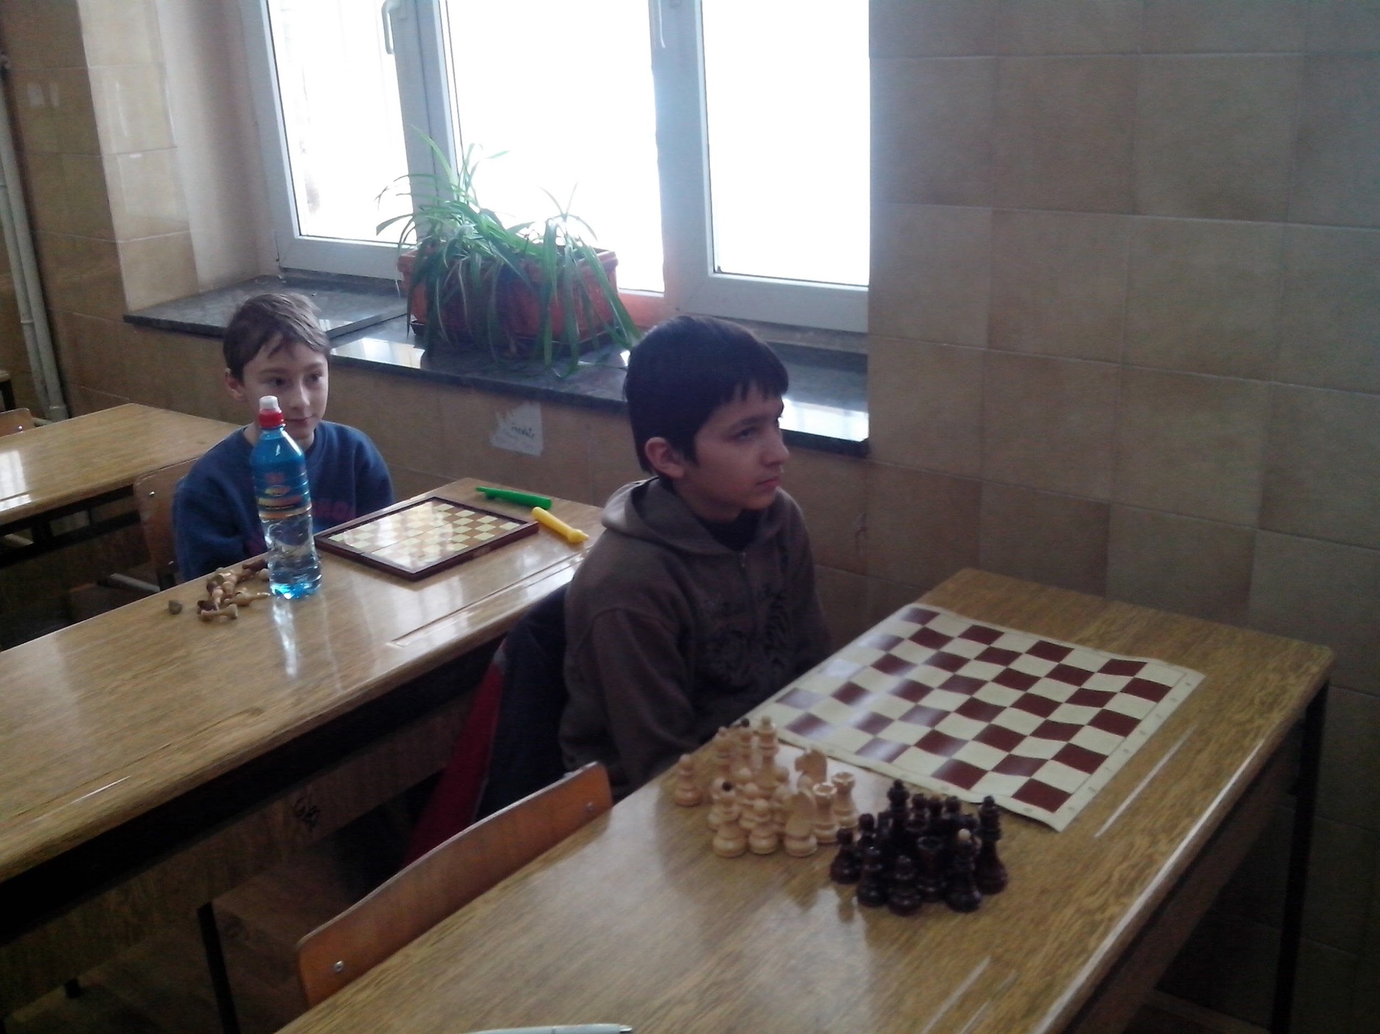
The youngest problemists prepared for solving (Ilija & Danilo)

Slide 53
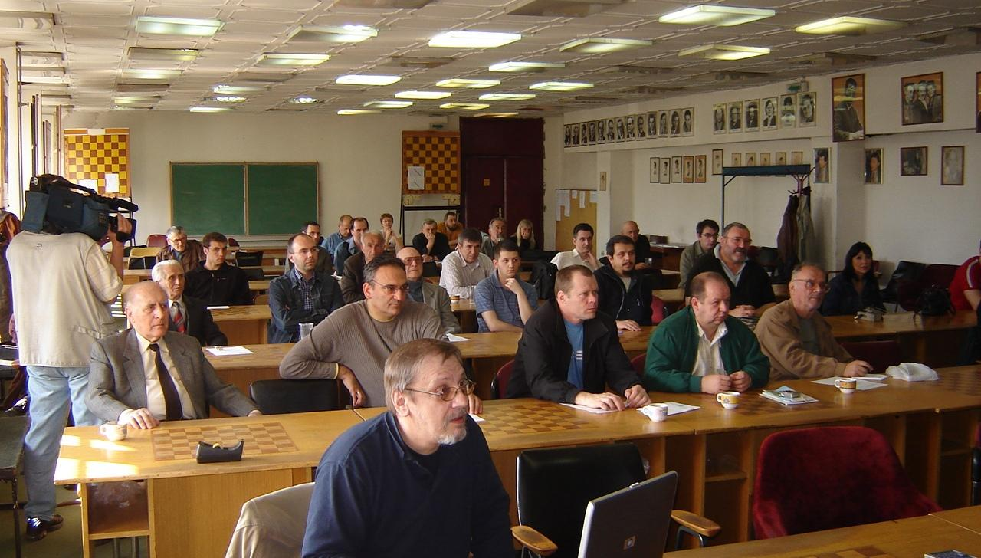
Milan Velimirovic runs Solving Show during BPCF 2008

Slide 54
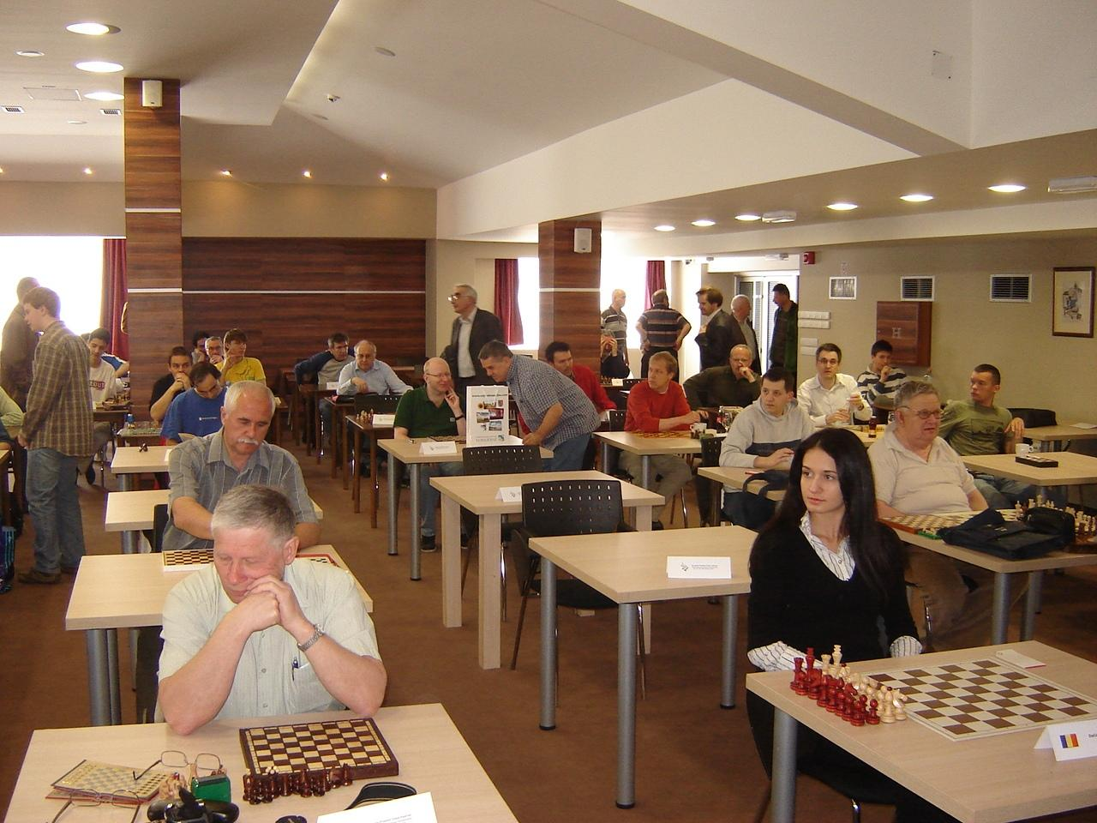
ECSC Subotica 2009

Slide 55
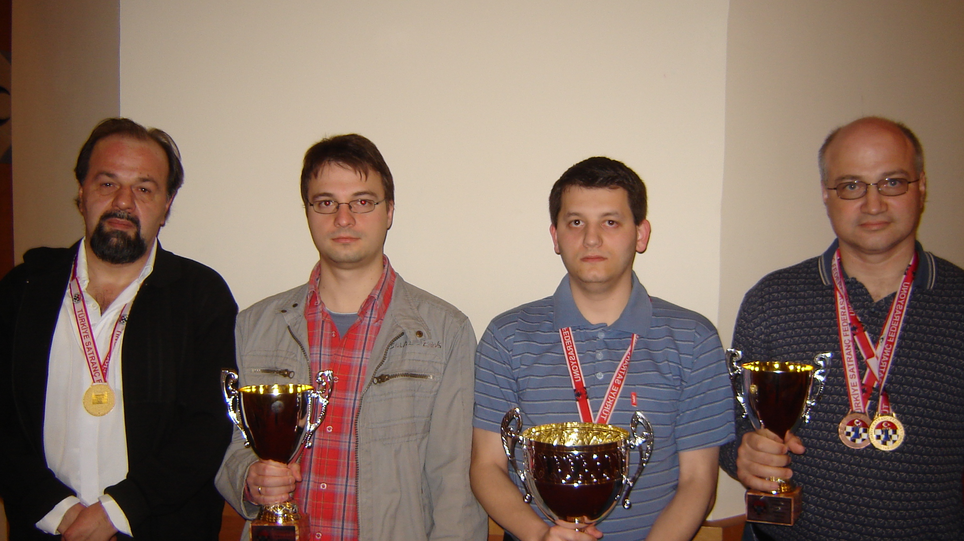
Serbian solving team won European Championship 4 times

Slide 56
Belgrade problemists organize Youth Solving Championship of Serbia (U10, U14, U18) every year, and a unique Problem Chess School for children 11-17 years old. Six of these kids have already published their chess compositions.

Slide 57
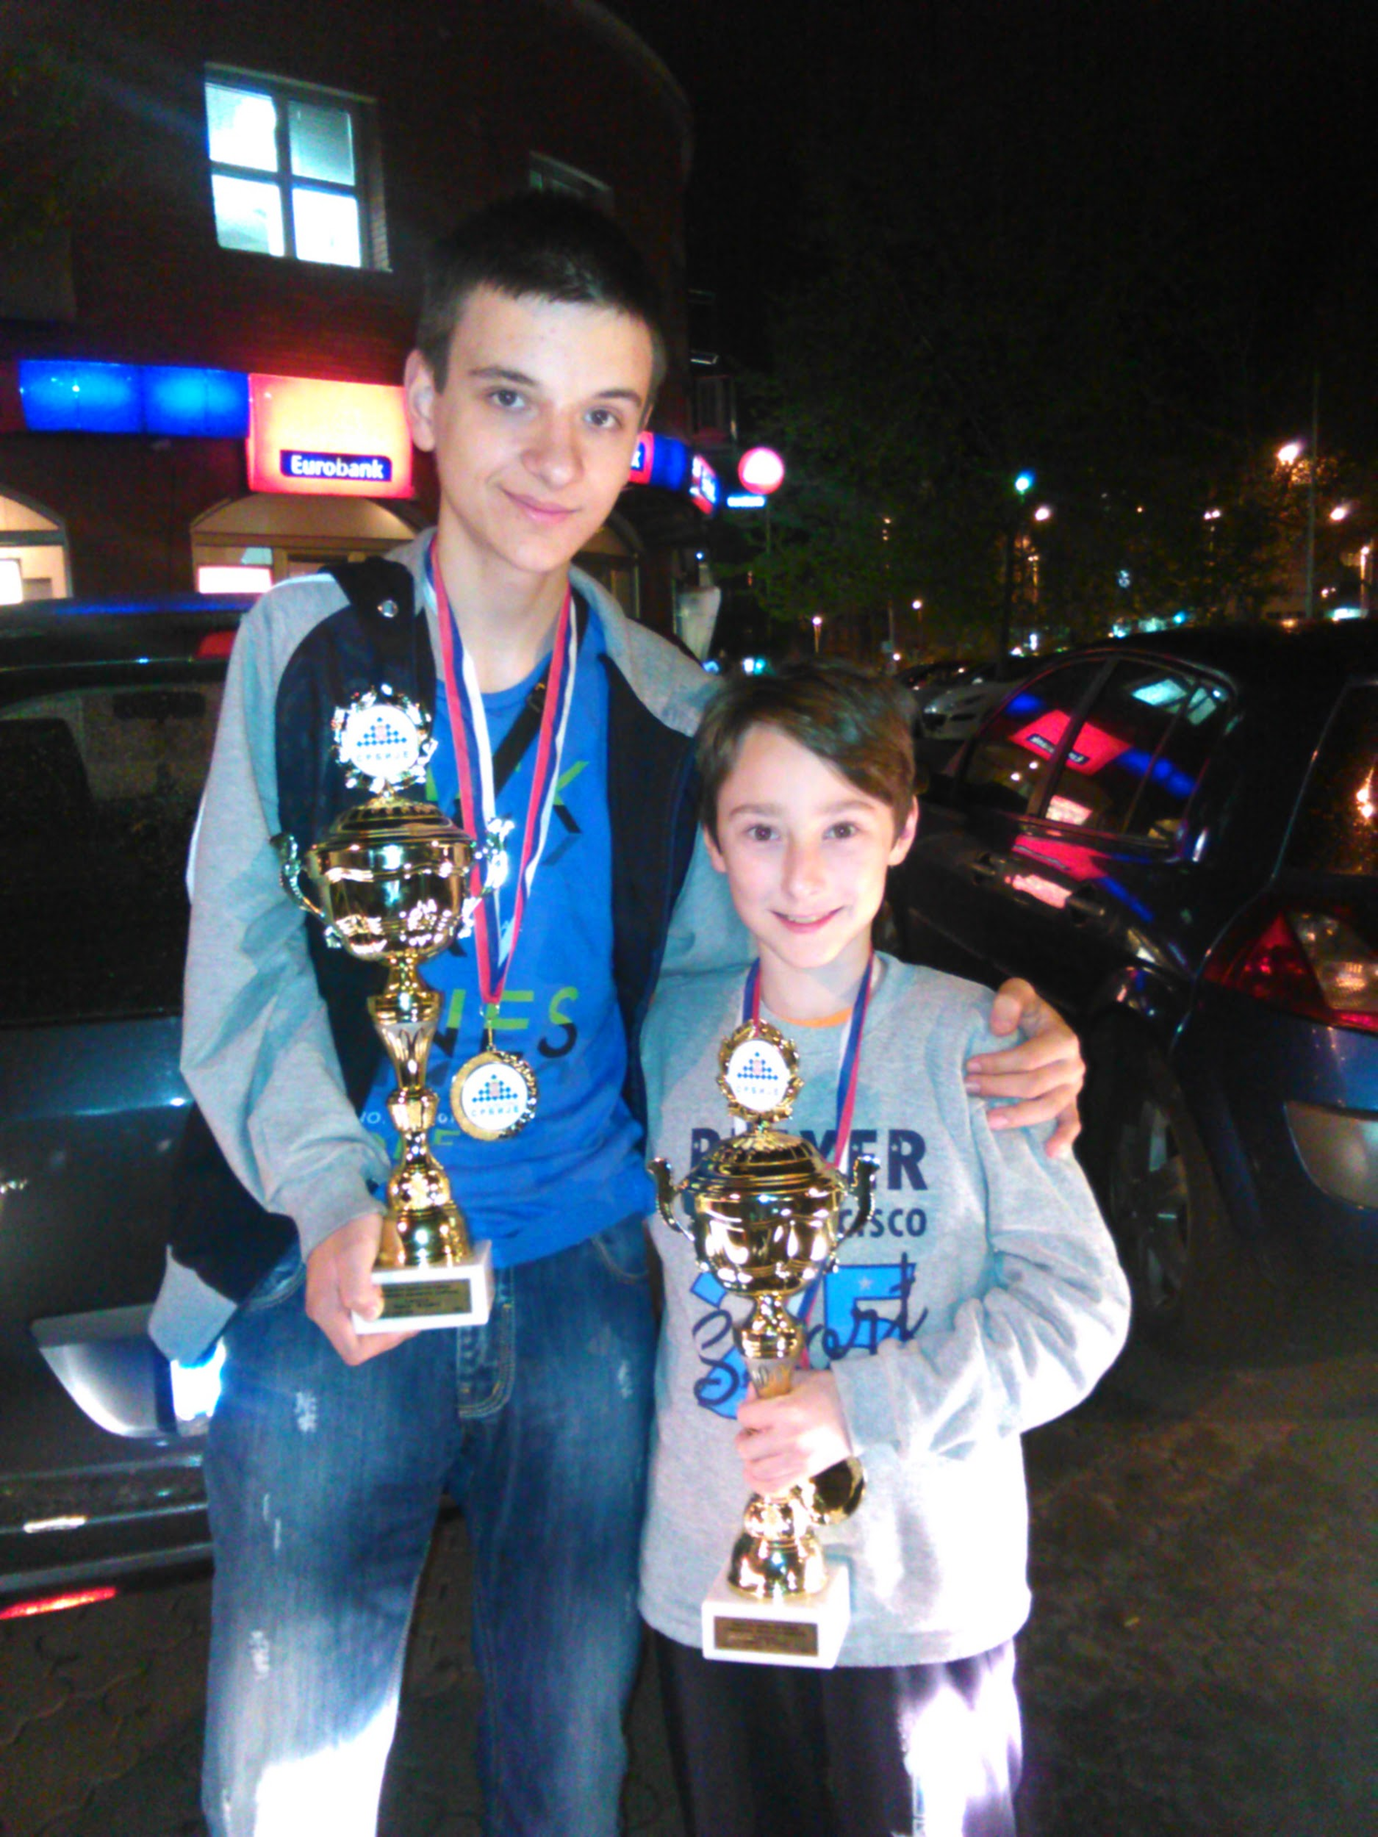
Zivojin (16) and Ilija (11) won U18 and U14 national solving championships 2015

Slide 58
Belgrade at night

Slide 59
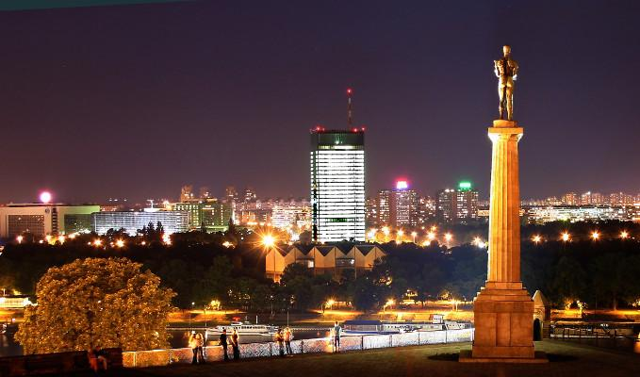

Slide 60
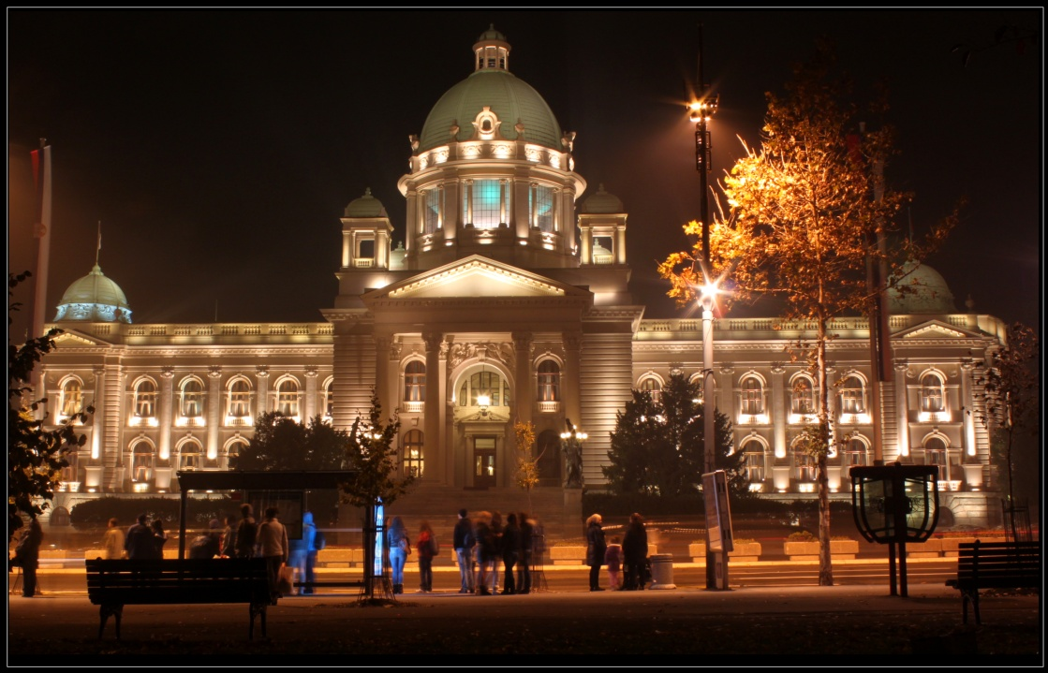

Slide 61
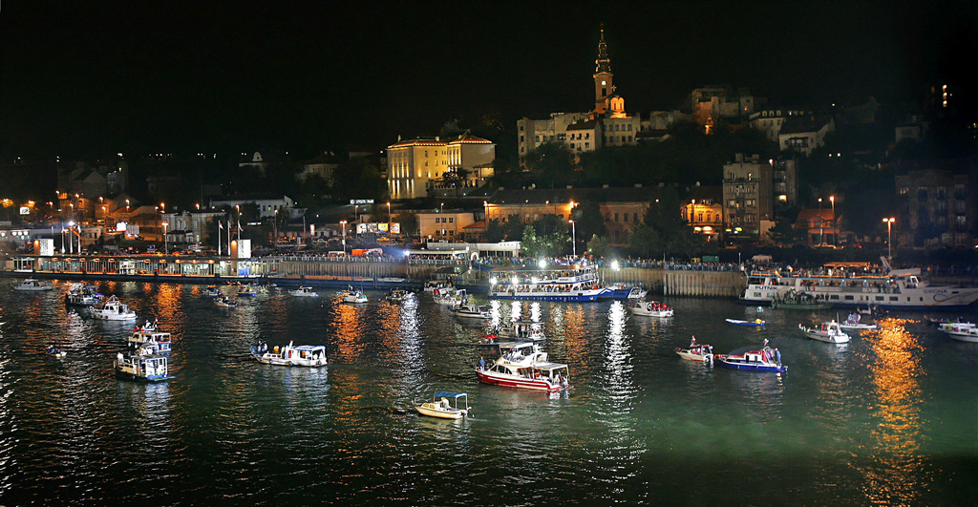

Slide 62
